Slide 1
Child Sexual Abuse 101
CRC Safe Church Ministry
Notes:
Welcome! We are here today to focus on something that we would rather not talk about. Thank you so much for coming! Your presence here shows a commitment this community and to one another. As we spend time learning about sexual abuse, we will be better equipped to recognize it, to prevent it, and to make this place a safer place for everyone. THANK YOU.
Introduce self.

Slide 2
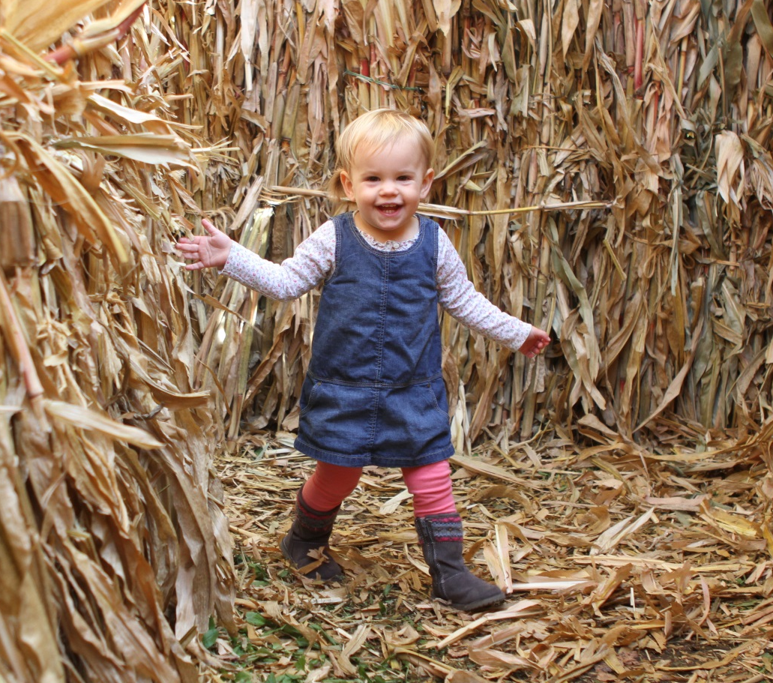
CRC Safe Church Ministry
Equipping congregations in abuse awareness, prevention, and response
Abuse Prevention policies & education
Abuse Response In & outside the church
Photo courtesy of Dan Nicholas
Photos by Dan can be found at : www.dannicholasphotography.com
Notes:
Bonnie’s granddaughter – could be anyone’s daughter, granddaughter, niece, cousin, sister, or future spouse. Each child is valuable to us and Jesus loves each one more than we can imagine. It is our responsibility, as adults in our communities, to protect and nurture our children.
Safe church Ministry equips churches in abuse awareness, prevention and response. Safe Church offers resources, but it can’t all come from an office in Grand Rapids. It takes all of us working together. Synod has encouraged each classis to have a safe church team, to help make all of our congregations safe places for everyone.
Most abuse doesn’t happen in a church. So, in addition to maintaining a safe environment at church, we, as Christians, need to be at the forefront of the movement to end sexual abuse – just as Christians have been at the forefront of other justice movements such as civil rights.

Slide 3
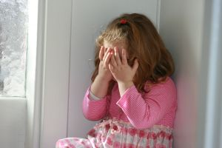
Not an Easy Topic
1 in 4 girls
1 in 6 boys
sexually abused by age18
It’s NOT OK!
Sexual abuse is hidden among us.
We don’t know what we don’t know.
Photo courtesy of Thomas Norsted www.freeimages.com/photo/776852
Notes:
We wish we could just close our eyes and make it go away. This is a sobering statistic, 1 in 4 girls, 1 in 6 boys; it’s almost hard to believe because it remains so hidden. It is among us, and we don’t even know it.
What that means is that even though we may not know about it; our congregations include many people who have been impacted by sexual abuse. I’m wondering how many of us in this room know someone, a friend or family member who has experienced sexual abuse. It’s a lot of people. And for some of us this may have impacted us personally. We know that ignoring, or pretending a problem doesn’t exist is no solution. Healing can never happen without first acknowledging the problem. We have a problem, and it affects all of us in different ways. This is not an easy conversation.
Image: http://www.freeimages.com/photo/776852

Slide 4
The Short Course of Abuse
Expect DENIAL from everyone – including yourself
Abuse is primarily about POWER and CONTROL
Offenders use GROOMING tactics
What is seen and heard is only the TIP OF THE ICEBERG
CHAOS breaks out when abuse is disclosed
Notes:
#1 – Expect Denial. We simply don’t want to believe that sexual abuse happens, especially when a child is involved. We have to recognize our natural tendencies to NOT believe, and to minimize, because this is just too horrific. We can’t even imagine it, especially when it involves a child, and especially when the one who perpetrates the abuse is such a nice person, maybe someone we’ve known and trusted. It’s easier to believe that it’s not true than to believe that this kind of thing really happens.
#2 – We must understand that sexual abuse is not primarily about sex it is primarily about power and control over someone else. Though it may involve sexual gratification, that is not the primary purpose. Sex is a tool that is used in exercising power and control.
#3 – Often a grooming process of several months or even years leads up to sexual abuse, we will talk about this more later so that we can understand better how this happens. It’s not just an “out of the blue” sexual encounter, there has been a process to make the abuse possible and to keep it hidden.
#4 – There is so much “under the surface” It’s difficult to wrap your head around it and the situation becomes very complicated very quickly. What is publicly known is usually only the tip of the iceberg.
#5 – For all these reasons, when abuse is disclosed – Chaos breaks out – it is a very difficult situation with long term consequences for all parties and for the entire community.

Slide 5
Where Blame belongs
Be Aware: We all have a strong tendency to place blame on the one who has been sexually abused
That person caused the trouble
If it’s that person’s fault, I feel safer
Abuse will never end until those who abuse stop doing it – the blame belongs here
Notes:
Just as there is a strong tendency to deny sexual abuse; there is also a strong tendency to blame those who have been victimized. Maybe there was something they did, an unwise choice that may have “set them up” for abuse, or they should have recognized the signs, or they should have known or seen where things were headed, or they should never have let this happen. (A story comes to mind of someone who was punished by her parents after she disclosed abuse by an older cousin because she “let a boy touch her” – she was only 6 years old; her cousin was a teenager). It somehow makes us feel safer when we can put some part of the blame on the one who has been victimized. We see it in the media in highly publicized rape cases where the character of the one victimized is called into question. As if the fact she was drinking means she wanted to be raped!?
NO ONE deserves to be sexually abused and the blame must stay with the one who perpetrated the abuse, regardless of circumstances.
Those who have been sexually abused are usually already blaming themselves and feeling huge amounts of shame. We must carefully guard against our tendency to place any additional blame or shame on the one who’s already been hurt. That’s not where the blame belongs.

Slide 6
Why is this important?
We Follow Christ in Community
The misuse of power in abuse is contrary to the Gospel of Christ (Philippians 2)
Each person is created in God’s own image and deserves to be treated with dignity
We are One Body (1 Corinthians 12)
We are called to be salt and light (Matthew 5)
Jesus loves children (Mark 9)
Notes:
We are called to follow our Lord, Jesus Christ. That is reflected in the way we live in community with one another. Safe Church Ministry exists to equip congregations to live into this calling. These are the key biblical themes that provide the foundation for Safe Church Ministry.
The misuse of power is at the heart of all abuse. Whether it’s sexual abuse, physical abuse, emotional abuse or spiritual abuse. Underneath it all lies the misuse of power. Jesus is our example – he had all power in heaven and on earth, and he gave up his power for the sake of others, out of his love for them. He shares his power with us through the Holy Spirit. Power used as Christ used power always leads to flourishing.
It’s the opposite of abuse where power is used for selfish gain, to diminish, or to harm.
According to Genesis, each of us are created in the very image of God and deserve respect.
We are one body and when one part hurts the whole body hurts, making the whole body dysfunctional. We have many hurting parts in the body of Christ.
In a culture where disrespect is common, we are salt and light as we value each and every person, loving them, treating them as they deserve.
Jesus loves children and we reflect his love as we also love and care for the children in our midst – that also means protecting them from abuse. What message are we sending when we fail to protect our children.

Slide 7
Definitions
Sexual Abuse:
Any act of a sexual nature performed in a harmful and/or exploitive manner, as with a child or with a non-consenting adult, for the purpose of sexual gratification and/or for the purpose of gaining power and control
Touch: inappropriate fondling, touching, intercourse
Non-Touch: sexual comments, pornography, watching sexual activity
Notes:
So what are we talking about when we say sexual abuse? This is just one definition – there are many definitions; different legal definitions exist in different states and provinces. But this gives us a general idea. The key aspects are that it is harmful and/or exploitive. It is not consensual. We must be aware that consent implies an equal power balance in the relationship and a shared understanding of the meaning of the action. So, an adult and a child cannot have consensual sex because the child is not able to give meaningful consent. This also comes into play in situations where one person has more authority and power than another in a relationship such as a teacher/student, boss/employee, doctor/patient, or pastor/congregant – these positions of authority make meaningful consent impossible.
We should also note that abuse does not always involve direct contact. Unwanted exposure to sexually explicit language or visual images also constitutes abuse and can be especially damaging to children.

Slide 8
Impacts for Children
Trauma & brain development
Cognitive delay: language development, intelligence, trouble in school …
Emotional impairment: attachment disorders, inability to form relationships, isolation …
Spiritual formation stunted: inability to believe that God is good or that they are loved by God
Notes:
Children are created and designed by God to be nurtured and cared for – not to be abused.
The effects of abuse on children is devastating. These same effects also show up when children witnesses abuse, even if it does not involve them directly.
Chemicals are released into the brain during traumatic events that have various impacts over time and affect brain function as well as it’s very structure (traumatology research). These ongoing impacts over time can be significant, affecting childhood development in so many ways, cognitive, social-emotional, and also spiritual.

Slide 9
Impacts for adults
Impacts can last a lifetime
Health Impacts: obesity, gastro-intestinal problems, headaches, diabetes
Psychological Impacts: depression, anxiety, low self-esteem, addictive behaviors
Spiritual Impacts: inability to trust and form relationships, loss of faith & hope
Notes:
The impacts of abuse are long-lived and often go very deep
Those who have suffered abuse show a much higher incidence of all kinds of negative outcomes than the general population – there is a high correlation between these impacts and abuse experienced. How many have heard of ACES – Adverse Childhood Experiences Studies? People with a higher score, or a higher number of Adverse Childhood Experiences have more difficulty in life and show higher incidence of all kinds of negative outcomes. That’s another reason to talk about these things and bring them out into the open where healing can begin – they don’t just go away when we ignore them. The trauma comes out in other ways. People who have suffered sexual abuse may not be in touch with their feelings, they may respond inappropriately in situations and not understand why. The unresolved trauma of abuse impacts the way a person feels about themselves, the way they relate to others, and their relationship with God – it affects everything!
So, even if abuse doesn’t happen in our church building; it still has an impact in our congregations. It affects all of us directly or indirectly. (remember, we are one body)

Slide 10

Indirect Impacts
Family members and friends are impacted by abuse of loved ones
Communities are affected
As the body of Christ,
what affects one part
affects the whole body
Photo courtesy of Tyler Neyens
www.flickr.com/photos/squeeksrocks/15828798485
Notes:
You may have heard the term vicarious trauma, which can be experienced by those who are close to and love the person who has experienced the trauma. They may have some of the same symptoms as those who have been directly affected. There may be a feeling of helplessness, confusion, not knowing how to respond and how to be helpful as they watch their loved one struggle with the impacts of sexual abuse.
Whole communities can be affected – Think about the sexual abuse scandal that happened at Penn State, and how that has affected the entire college community. It has also led to all kinds of new state laws to protect children from sexual abuse.
What happens in the body of Christ? We are one body, with lots of hurting parts that can make the whole body dysfunctional. We simply can’t be all that we are called to be as the body of Christ if we ignore these hurts.
Image: http://www.istockphoto.com/vector/human-body-34688284?esource=AFF_IS_Linkconn_SP_www.freeimages.com_141052&asid=308966&cid=5418&lid=13

Slide 11
An ounce of prevention
“An ounce of prevention
is worth a pound of cure”
It’s never more true than in situations of abuse
The best strategy is to stop it BEFORE it happens
So, how does this happen?
When we understand more, prevention efforts are more effective.
Notes:
Understanding more about how these things happen will help us be better equipped to recognize the signs and stop abuse before it happens. As I’ve said before, sexual abuse doesn’t just happen “out of the blue”; we are going to look at a process that often takes place leading up to sexual abuse, a process known as “grooming”

Slide 12
Grooming
Phases of Grooming Behavior:
Engagement – targeting and building trust; isolating and creating dependence
Sexual Interaction – Gradually increased sexually inappropriate behavior
Secrecy – Maintaining control in the relationship, blame, threats, etc.
Notes:
Engagement: First there is a conscious decision to engage the child in a relationship of trust by using various strategies such as: Making the child feel special, listening and sympathizing, giving secret gifts or treats, giving privileges, etc. Once the child’s trust has been gained, often the one offending may create distance, or drive a wedge between the child and parent(s) and/or may befriend the parents to earn their trust and gain access to the child. The one offending may also test the child to see if he or she will keep non-sexual secrets. This engagement phase can last a long time before any abuse occurs. And it can also occur between adults.
Sexual Interaction: The relationship becomes sexual very gradually, hugs that last a little too long, special touches, etc. Sexual activity can include pornography, fondling, masturbation, digital penetration, penetration with small objects, or intercourse. This betrayal of the relationship and betrayal of trust is very confusing to the one who is being abused, whether child or adult. There is already a strong connection with the person, and the relationship has been beneficial, there are good parts to it – only now it’s not the same; how to interpret the sexual behavior becomes complicated. It’s important to note that in most incidents there is no physical evidence of abuse, and even when there is, children heal quickly.
Secrecy: There are many reasons why abuse is not disclosed. Because of the way the relationship has progressed gradually there is often much shame and self-blame associated with the abuse. What are some other reasons that a child may not disclose abuse?

Slide 13
Phase 4: Disclosure/Discovery
What prevents disclosure?
Fear:
Of not being believed
Of real or perceived threats
Of causing trouble or being punished
Of impacts on relationships that are important (parents, family, or friends)
Of consequences to the one perpetrating abuse (they may be taken away or go to jail)
Notes:
It’s very difficult for a child, or for anyone, to disclose abuse that they have experienced. Many of these fears are very real. We need to work to make it easier to disclose abuse and provide safe spaces to talk about what’s really going on in our lives.
They may have been told by the one who has abused that “no one will believe you” – and remember, denial is the common tendency. Unfortunately this threat is often true.
They may have been threatened with various actions if they ever tell anyone.
They may fear what will happen, or what will be the impact to family or loved ones once abuse is disclosed. ( people will be upset, things will change)
And because there is often a strong relationship of dependence on the one who has abused, they may stay quiet to prevent negative consequences that person. (does a child want an offending parent to go to jail?)

Slide 14
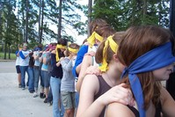
Phase 5: suppression
Optional but typical!
Those who discover the relationship tend to:
Deny or Minimize
Redefine
Blame
Leads to "retract” or
stop talking
about what happened
Notes:
This is what can easily happen if we don’t make intentional efforts to respond in appropriate ways when abuse is disclosed or discovered. It’s sad that this is “typical” but it’s true.
Image: http://www.freeimages.com/photo/do-you-trust-me-1310128

Slide 15
Response is Critical
What children need:
To be believed
To be told it’s not their fault
To be told that they are not alone
To be reassured that they will be helped
To know what will happen next
Notes:
We can cause secondary wounding by responding inappropriately.
Many survivors have been hurt again, re-victimized by the way the church has responded to their disclosure of abuse. Our response is critical.
Of all places, our congregations need to be places of compassion, of support, and of healing, not places of rejection and increased wounding.

Slide 16
Those who abuse
There is no one personality – all walks of life
Common characteristics include:
Often popular, charismatic, and well respected
Often good at minimizing, denying, deceiving and manipulation
May have a sense of entitlement
May seek positions that give them access to children or vulnerable adults
Notes:
It’s also important for us to better understand those who choose to abuse. Those who abuse are not monsters – they are people just like us.
Many of these common characteristics have made it easier for them to perpetrate the abuse, and may make it harder for us to believe it when it’s discovered or disclosed.

Slide 17
Response is Critical
Those who sexually abuse need:
Specialized professional services to change behavior – group intervention
To take responsibility for their actions and acknowledge the harm done
Strict accountability for a long, long time
Notes:
Specialized professional services may be required to change abusive behavior – group intervention has been shown to be helpful (group members can hold one another accountable)
The tendency to minimize and deny is very strong in those who sexually abuse others, often they lack the empathy to understand and acknowledge the harm they have caused.
After a sexual offense, especially a criminal sexual offense against a child, strict accountability is needed for a very, very, very long time. The risk of re-offense is real and we must guard against it. In many professions (doctors, nurses, teachers, therapists, social workers and others), a license is revoked, with no option for reinstatement when a criminal sexual act against a child is discovered. A serious crime has serious consequences. There is no option for reinstatement. Many believe that pastors and office bearers should be held to equally high standards.

Slide 18
A Word about forgiveness
Forgiveness is NOT an alternative to justice
Quick forgiveness can be very harmful to everyone involved
Forgiveness is separate from reconciliation
Forgiving the unforgivable
(Deep wounds leave scars, which “remember” the pain)
Jesus said, “Father, forgive them…”
Survivors of abuse may need to do the same
Notes:
We must consider carefully how we talk about forgiveness with those who have experienced sexual abuse. It can become a huge roadblock for them. They feel the pressure to “forgive”. “Forgive and forget” is a common phrase, yet the deep wounding cannot be forgotten. This is very serious wounding and the regular day-to-day forgiveness that we all must employ to live in community doesn’t apply in this situation. To forgive sexual abuse is a very long and difficult process, that process must be honored in our congregations.
First we must realize that forgiveness is not an alternative to justice. Those who perpetrate abuse need to be held accountable. Those who have survived abuse must be believed; the harm done must be acknowledged; there must be opportunity for restitution; etc. Forgiveness does not negate the need for any these things.
It may take years to even understand the damage that has been done in sexual abuse, and there is no true forgiveness without understanding that. Quick forgiveness can block the way towards healing both for those who offend and those who have been hurt by abuse.
There may not ever again be enough trust in the relationship for reconciliation. In other words, things may not ever go back to the way they were before.
How do you forgive that which is unforgivable. There is no way to ever make right the damage that abuse has caused. Only God can do it – All things are possible with God.

Slide 19
Questions? Need More information?
Safe Church Ministry
www.crcna.org/safechurch

