Slide 1
Maintaining a Safe Church
They will live in safety and no one will make them afraid --Ezekiel 34:28
Notes:
One of the best prevention tools that we have is a strong Safe Church policy. Every church needs to have one. Children deserve it and increasingly, parents expect it.
A policy sends a strong message that this is a church that follows Jesus’ example and shows concern for “the least of these” by protecting those most vulnerable among us, especially our children.

Slide 2
Safe Church Top 5 Goals
#1 Every church has a policy to prevent abuse!
Safe Church Team members can help churches create and maintain policies
2. Every church uses a safe church curriculum
3. Every church follows protocol for responding to church leader misconduct
4. Issues of abuse can be freely discussed
5. Church leadership is committed to Safe Church
Notes:
The # 1 goal and best place to start is for every church to have a policy to prevent any abuse from happening at church. That is where we will focus this training today
The goal is for every church to have a policy – right now only about ½ of Christian Reformed churches have any kind of safe church policy (according to Yearbook reports). Of those, it is uncertain how effective they are. We don’t know whether or not policies are well-written, or whether or not they are being followed. It is a sad state of affairs for our denomination. That’s why your local Safe Church team is so important, they can help churches with this, every church should have a point person, or a committee who is responsible for abuse prevention at church.
These other goals are also very important to Safe Church Ministry in creating an environment at church where everyone is respected and feels safe.

Slide 3
Why Have a Policy?
How would you respond?
We all know each other here, so we don’t need a policy.
A policy requires background checks – that offends people. We’ll never get any volunteers.
We’re a small church and just can’t afford it.
Notes:
(Ask group and then give people time to respond – or get in small groups to discuss – then share with larger group.)

Slide 4
Rationale For a Policy
To create a safe place in church
To protect children
To protect staff and volunteers
To create an opportunity to talk about abuse
To respond to situations of abuse
To satisfy legal counsel’s request
To satisfy insurance co. requirements
Notes:
Knowing the reasons, or why we have church policies, may help motivate those who don’t see the need for a Safe Church policy.
It is the responsibility of the church council to provide a safe space that nurtures worship and faith – with a special mind to those most vulnerable among us.
Policies also protect church staff and volunteers from false allegations – very important in our culture of litigation.
Abuse thrives in silence and secrecy – We need to talk about it. If we don’t talk about it at church it will thrive here.
If we minimize or deny abuse; we do not respond well when we are faced with it – this can lead to more pain for those who are affected by it.
Legal counsel and insurance agents – should review all policies – excellent sources of information regarding reducing risk.
Having a policy sends a message that in this place, the infinite value of each person is honored and respected; therefore abuse is not tolerated. (Recommend posting policy on church website)

Slide 5
Getting Started
Gain support from leadership/A mandate
Form a committee/Various voices needed
No one policy works well everywhere/each church is unique
It takes time (18 mos.)/Process is helpful
Notes:
Creating a policy takes more than one person
You will want support from leadership and input from various people who are affected by the policy - a committee often works best. Members of a committee could include: a parent, a nursery worker, a youth leader, someone from Gems, Cadets or other programs, etc.
Each church has unique programs, buildings, resources, and personnel, etc. Therefore, no one policy will work for every church
The process of considering how to reduce risk and make your church a safe place is a valuable process. Expect it to take some time, but it will be time well-spent
When completed, policies should be reviewed by your insurance company and/or by legal counsel before becoming finalized

Slide 6
Important Considerations
POLICY MUST BE MAINTAINED & FOLLOWED!!!
Keep it simple
Supervision and accountability
Regular review – committee, legal counsel, insurance agent
Annual Training of staff & volunteers
Notes:
A policy that is approved and then sits in a file somewhere is not helpful. When asked about their church policy, pastors and church leaders have been known to say, “I’m not sure if we have a policy” or “we used to have a policy, but I wouldn’t know where to find it.”
If no one knows about a policy, it’s not doing any good. Policies must be followed.
Supervision and accountability should be incorporated into the policy – so should regular review and training of staff and volunteers.
Training staff and volunteers is another role for classis Safe Church Team members. Offering to do a training for staff and volunteers each year is a way to keep safe church in the minds of church leaders.

Slide 7
General Policy Components
Philosophy of Ministry – purpose for policy
Why do we have a policy?
Definitions – misconduct/abuse
What are we talking about?
Who? (Personnel summary)
Who is covered under the policy?
General Policies – clear expectations
What policies apply to almost all the programs?
Notes:
So, what needs to be included in a Safe Church policy? These are the basic components:
The philosophy of ministry, in addition to an approach to faith development also includes what we’ve already talked about, such as providing a safe place for worship and growth; respecting the infinite value of each person, etc.
Definitions are important (include handout w/definitions)
Who is included under the policy? Who needs to know about it and receive regular training? (Staff, Council, Volunteers, etc.)
Policies are a way of providing all parties with clear expectations

Slide 8
Specific Policy Components
Discipline Policy – response to misbehavior What are appropriate discipline techniques?
Transportation Policy – must conform to local laws What are the risks involved in transportation?
Supervision Policy – maintain accountability Who is accountable?
Screening Policy – Criteria for selection Is a criminal background check enough?
Notes:
Some situations represent a greater risk than other situations and therefore need more specific guidelines.
Discipline situations – different people have different ideas about what is appropriate discipline. At church, each person must be respected. Discipline situations must be handled in a professional manner (handout – policy examples)
The two areas where churches are most vulnerable legally are supervision and screening. Negligence in one of these two areas can lead to legal trouble.
Due diligence needs to be done in screening for those who work with children and vulnerable populations
Regular lines of authority and responsibility need to be established – Who is ultimately responsible for what goes on in Sunday school or at youth group? What lines of accountability are in place?

Slide 9
A Note about Screening
Criminal Background Checks:
Various kinds of checks are available - Costs and Risks must be weighed carefully
Part of an overall selection process - Application, Interview, References, etc…
Known Person – someone who has been a part of the congregation for awhile (1 year)
Notes:
There are some scams out there – a reliable source for providing criminal background checks is needed
Limitations:
Sex offender registry – limitations: only criminal sexual offenses that involve a minor – only convictions (plea bargains made may not show up)
State or provincial checks – limitations – local only
(in Michigan, I-CHAT offers free background checks for non-profits)
Nationwide checks – a better option (Sex offenders may move to new places)
Fingerprinting – another better option, but expensive
No matter how thorough a background check – it is only good at the moment – not a predictor of future behavior – also does not show unreported cases

Slide 10
Policy Highlights
Look over your church policy, see if it includes:
The basic components (philosophy, definitions, general guidelines, discipline, transportation, supervision, screening)
Provision for training volunteers and staff
Reporting guidelines
A system for regular review
Notes:
This is the time to look at your individual church policy – – note what people notice about it – answer questions
If the group is large you may want to divide into smaller groups for more interaction.
Do people feel comfortable with the policy?
Does it go far enough in ensuring a safe environment?
If changes are needed, what are next steps,? a review committee, a training event, etc. Determine who will follow through and when?

Slide 11
Sexual Predators
Think of the African Savannah
Various kinds of vulnerability:
Physical – Smaller size, weaker strength
Social – Marginalized, separate
Cognitive – Trust (Grooming)
Emotional – Lacking ego strength
Spiritual – Misuse of Scripture
An Elephant Story
Notes:
This comes from a conference where the topic was sexual predators – the speaker showed some video clips. We don’t have the video, so imagine with me. (close eyes)
Think of the African Savannah… a lioness is prowling, looking for prey; how does she choose her victim. A hunting lion looks for a vulnerable victim – an animal who is younger and smaller, a wounded animal that is weaker, an animal that is alone and separated from the group. It’s the same with human sexual predators… they look for the same vulnerabilities.
Cognitive, Emotional & Spiritual factors also play a part:
Grooming – (Handout – steps of grooming)
Elephants protect their young by creating a circle around them (imagine). Our churches need to provide a circle of protection for our children and those most vulnerable among us. We need to be the strong protection around them, keeping them safe.

Slide 12
Responding to a Disclosure
Take it Seriously
Stay calm and reassuring
Do NOT promise not to tell anyone!
Affirm that it was good to tell someone
Affirm that it was not his/her fault
Do NOT investigate; LISTEN closely
PRAY & Follow up
REPORT– at church and to authorities
Notes:
Believe! Do not try to convince the child that the story is not true or did not really happen that way. Do not suggest an alternative explanation (such as a “dream”). Children don’t make this up.
Stay Calm! Resist the temptation to overreact with fear, disgust, or anxiety; the child may stop talking or may believe that you think they have been bad.
DO NOT promise not to tell anyone! Tell the child that you want to find help for everyone so that the child will be safe from the hurt.
Reassure the child that it WAS GOOD to tell someone & Remind the child that whatever happened WAS NOT his/her fault. No child deserves to be hurt
DO NOT investigate; LISTEN closely; don’t ask probing questions; write down the information immediately after the conversation while it is still fresh in your mind.
If appropriate, pray with the child. Keep the child & family in your own private prayers. Follow up in later weeks and months by showing concern and support. This will help reduce the shame.
Follow church reporting procedures, which should state who to report to, and should have report form to fill out and keep on file.

Slide 13
Reporting Suspected Abuse
When in doubt, report to authorities!
Mandated Reporters:
In Canada – everyone over 18 yrs. old
In USA – certain professionals, varies state to state – clergy need to know!
Report can be made anonymously
1st person recommended
Report only what was seen and/or heard
Notes:
Applies to vulnerable populations (children); not adults generally – in cases involving adults; the one victimized must be empowered by having the choice of next steps to take on his or her own behalf.
On the other hand, we must take it on ourselves to guard those who are most vulnerable among us, children, the elderly, those who are impaired, etc.
For more information: In the USA:
1-800-4-A-CHILD (1-800-422-4453)
http://www.childwelfare.gov/responding/how.cfm
In Canada:
1-800-668-6868 (Kid’s Help)
http://cwrp.ca/faqs
Mandated reporters can be held criminally and legally liable for NOT reporting if they know of suspected abuse and do not report it! (people have gone to jail – (think of Catholic church or Penn State situations).

Slide 14
Resources
Preventing Child Abuse: Creating a safe place by Beth A. Swagman
http://www.faithaliveresources.org/Products/
155243/preventing-child-abuse.aspx
Brotherhood Mutual Insurance Co.
www.brotherhoodmutual.com/index.cfm/
resources/ministry-safety/
Notes:
Beth Swagman’s book is an excellent resource – perhaps your classis Safe Church team could own a copy that churches could borrow to create or review their policy.
Brotherhood Mutual insures a lot of churches – their website has great resources. Also Christianity Today Leadership Journal in conjunction with Brotherhood Mutual has created a publication which includes a safety library. For a small annual fee you can have access to all the resources in their safety library.
Other Safe Church Team members are also good resources – as well as the Safe Church Ministry office. Don’t hesitate to contact us.

Slide 15
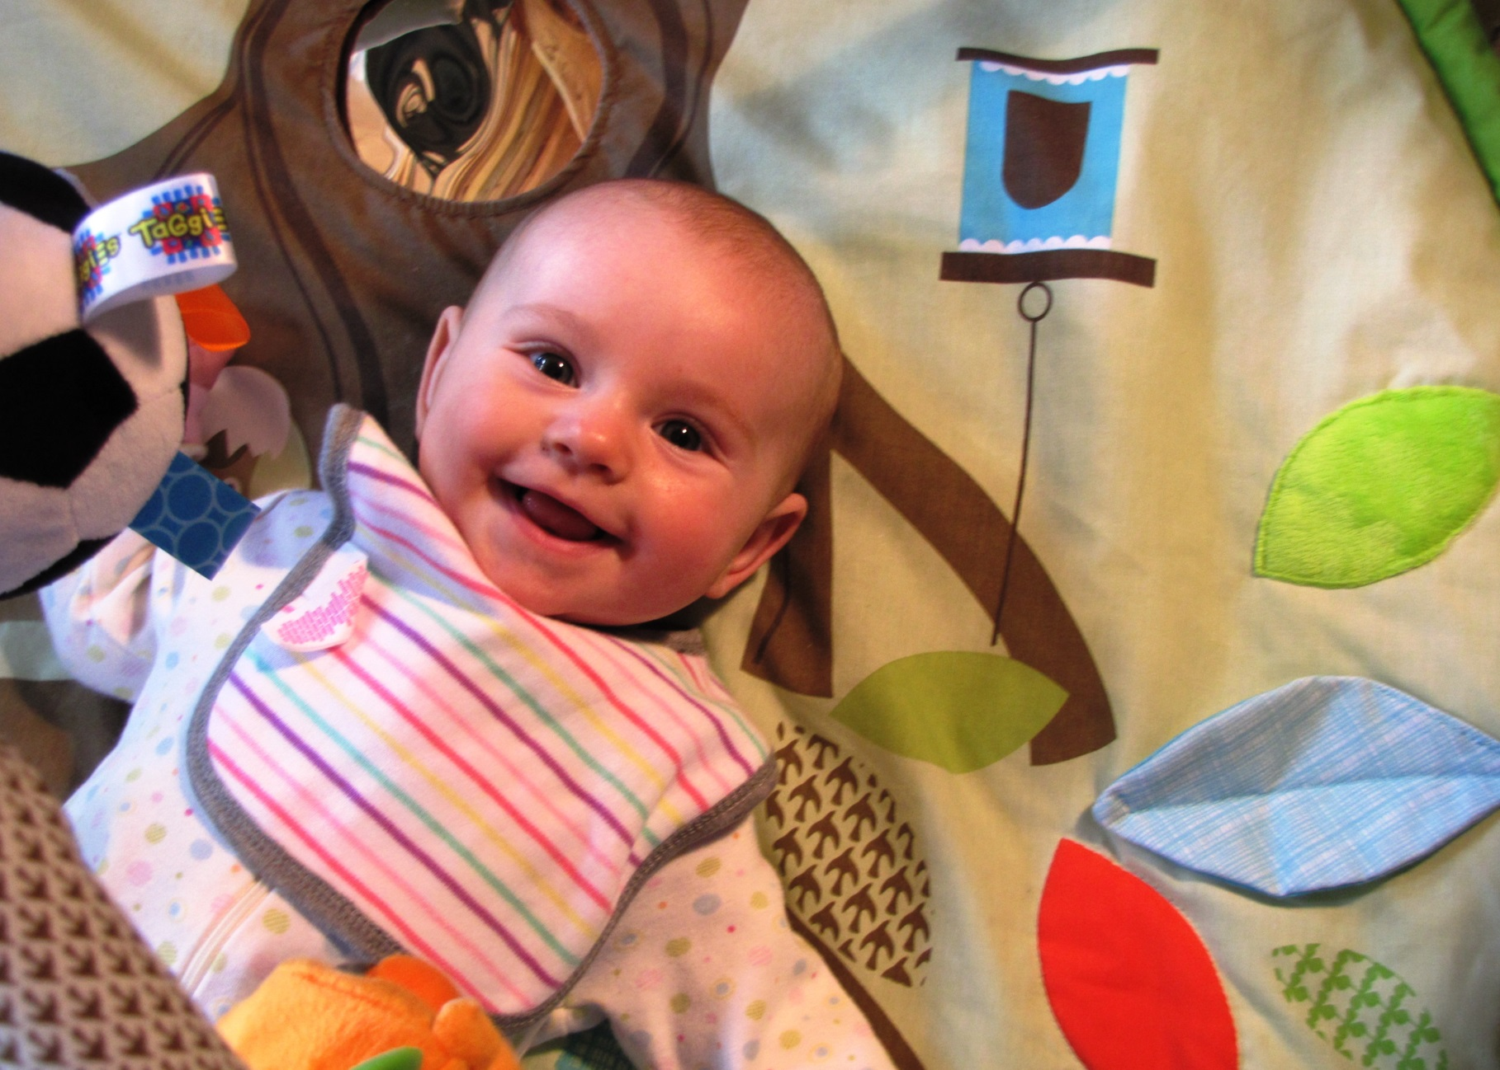
Notes:
This is somebody’s grandchild, someone’s daughter. Perhaps she will become someone’s big sister, a future wife, mother, friend, church leader…
She is also a covenant child of God. Shame on us if we don’t do all that we can to protect her from abuse. What message are we sending her when we fail to create and enact policies to keep her safe?
I’m sure that you can think of children in your own lives. Imagine how you would feel if something as devastating as sexual abuse happened to them. Safe Church Ministry works to prevent abuse, and to keep our children, and all of our members safe.

Slide 16
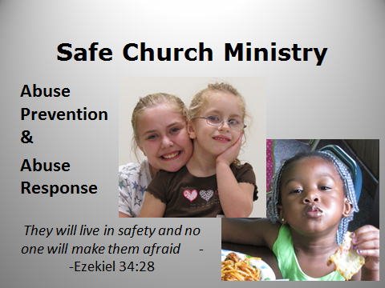
Questions?
Notes:
Safe Church Ministry cannot prevent all abuse – so when it occurs we also want to be ready to respond.
But prevention is the best strategy.
Questions?
(If you can’t answer questions please feel free say, “I don’t know, but I will try to find out”. )

