Slide 1
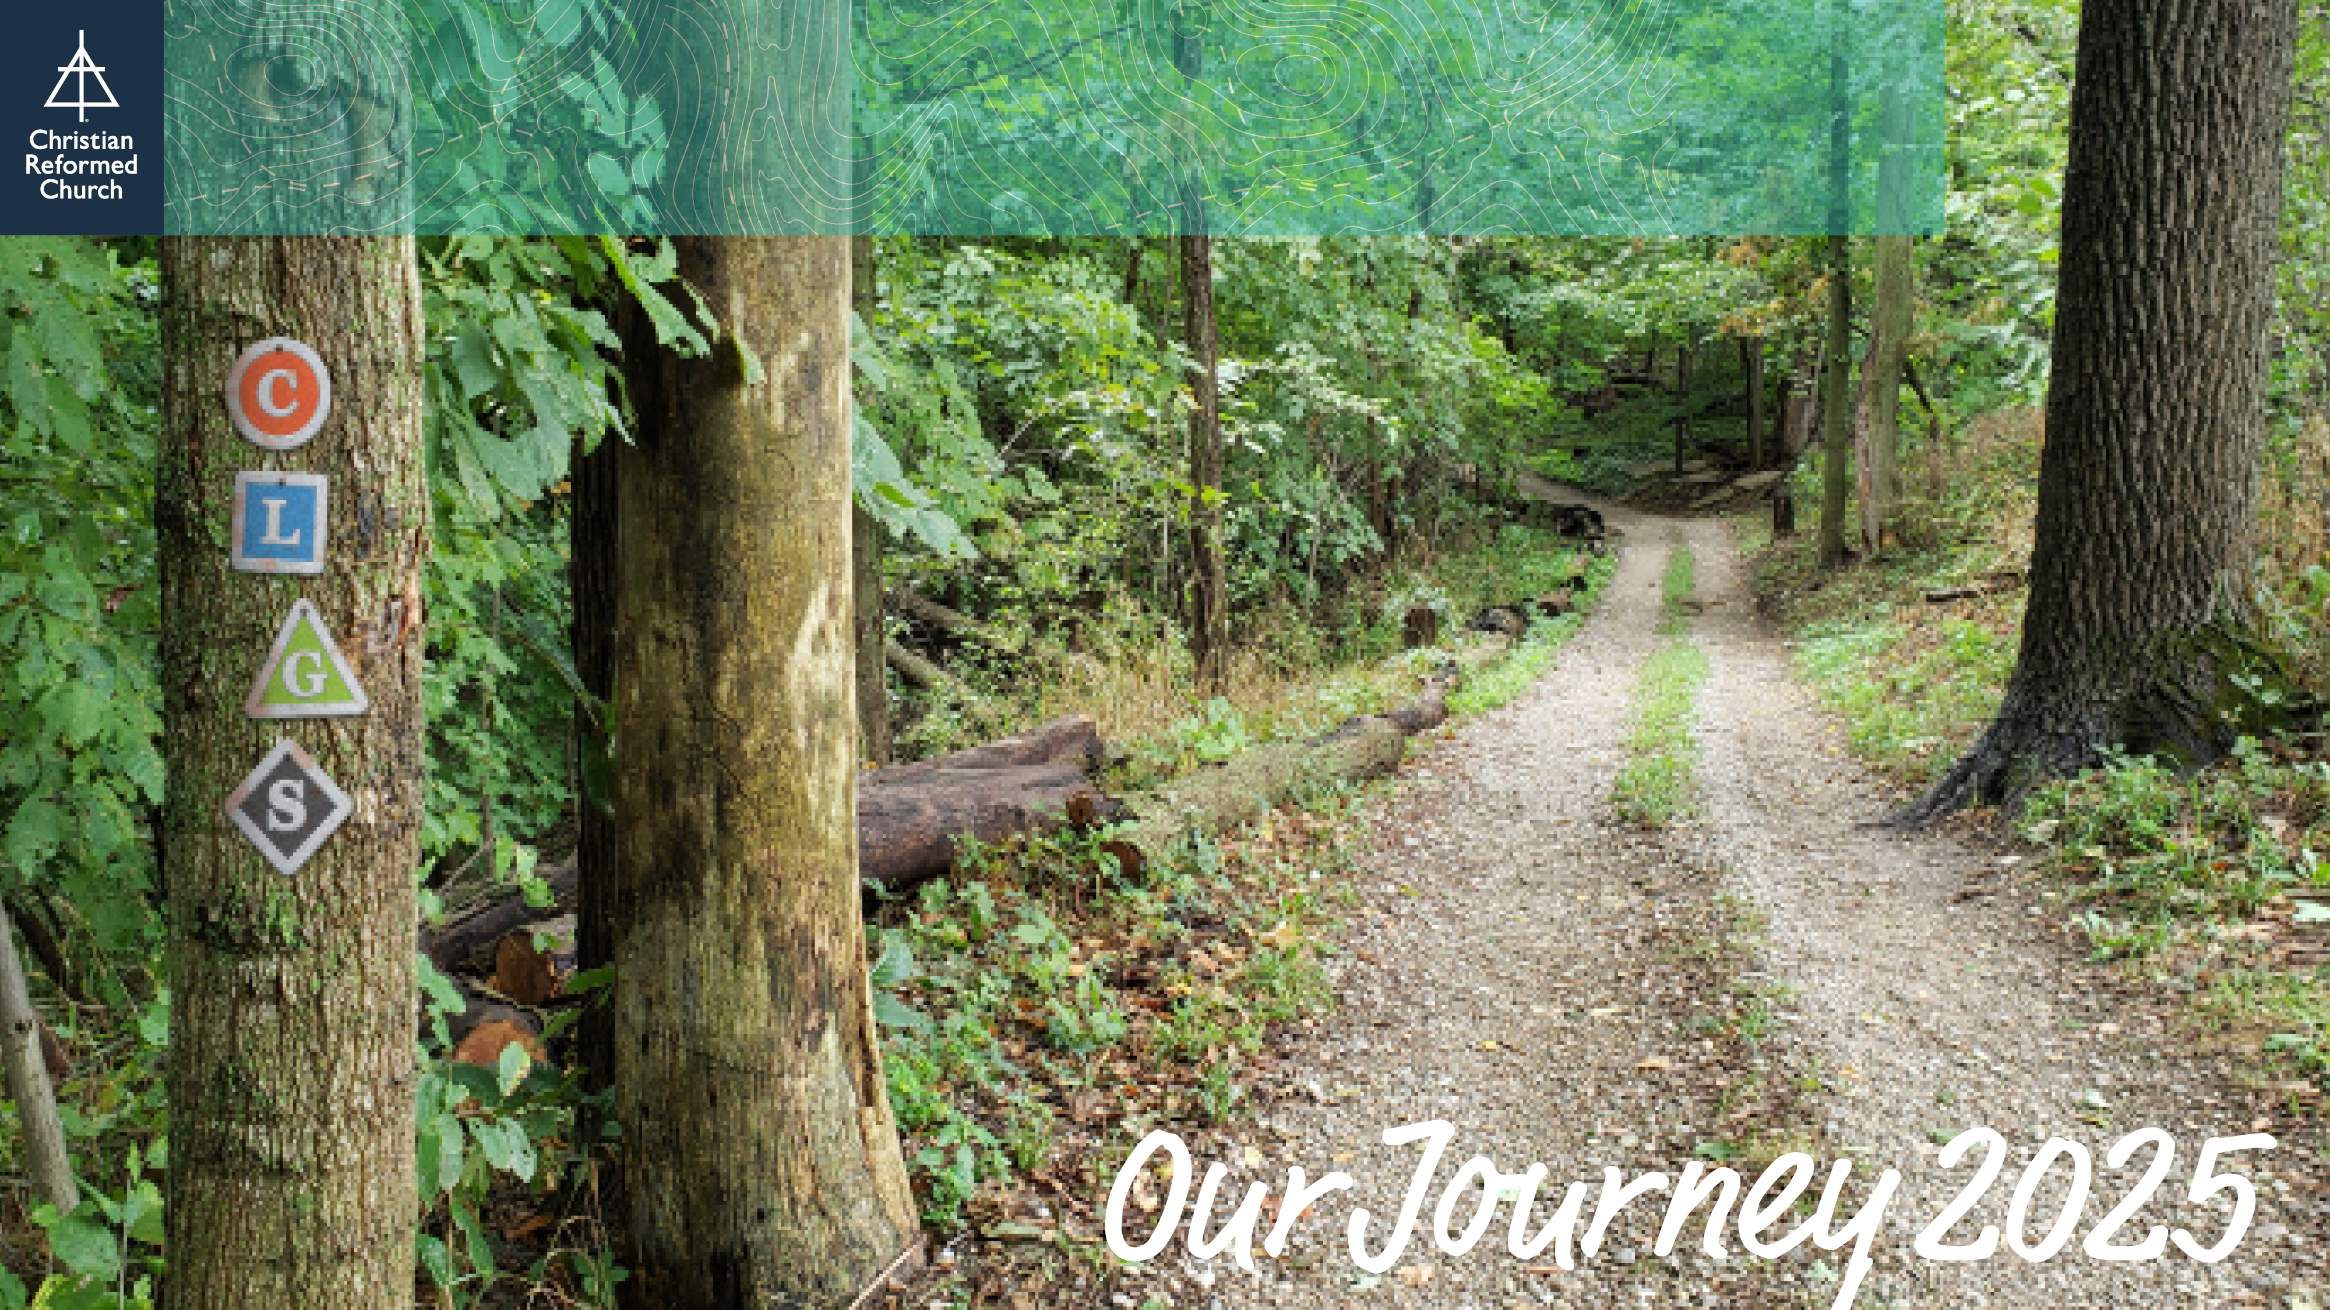

Slide 2

Our church is cultivating practices of prayer and spiritual discipline, transforming our lives and communities by the power of the Holy Spirit.

Slide 3

Our church is listening to the voices of every generation, shaping us for ministry together.

Slide 4

Our church is growing in diversity and unity by seeking justice, reconciliation, and welcome, sharing our faith as we build relationships with and honor the cultures of our neighbors and newcomers.

Slide 5

Our church is sharing the gospel, living it missionally, and planting new churches in our neighborhoods, as we discover how to connect with our local and global ministry contexts.

Slide 6
Learn more and find resources at crcna.org/OurJourney

