Slide 1
Immigration Timeline

Slide 2
Guiding Questions
What were the hopes and desires or fears that characterized this period in U.S. history?
How did those hopes and desires or fears inform political opinions on the topic of immigration?
For what reasons have our immigration policies aimed to welcome immigrants or deny entry to immigrants?

Slide 3
For what reasons have our immigration policies aimed to welcome immigrants or deny entry to immigrants?
Deny
Welcome

Slide 4
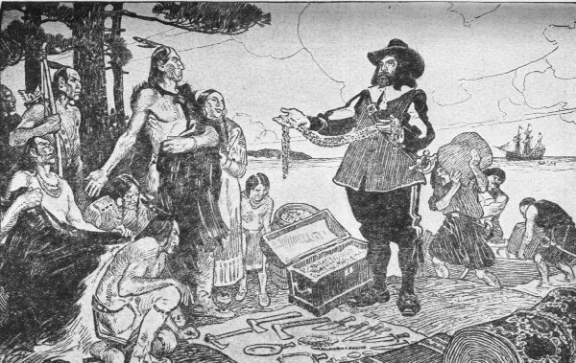
Public domain.
1
1584-1700s Colonization of the United States, marking the first wave of European immigration to the continent. A majority of Natives in North America were killed or displaced by European settlers.

Slide 5
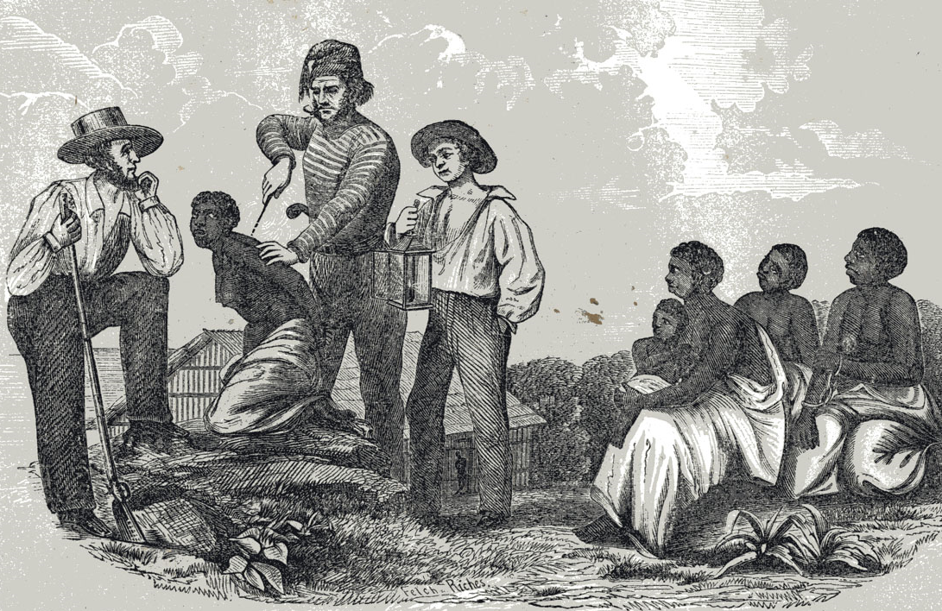
William O. Blake, The History of Slavery and the Slave Trade (Columbus, Ohio, 1857).
2
1619-1865 Africans were trafficked to the United States and enslaved. Slave-grown cotton became half of U.S. export earnings.
Notes:
In the pre-Civil War United States, a stronger case can be made that slavery played a critical role in economic development. One crop, slave-grown cotton, provided over half of all US export earnings. By 1840, the South grew 60 percent of the world's cotton and provided some 70 percent of the cotton consumed by the British textile industry.
https://www.gilderlehrman.org/history-by-era/slavery-and-anti-slavery/resources/was-slavery-engine-american-economic-growth

Slide 6
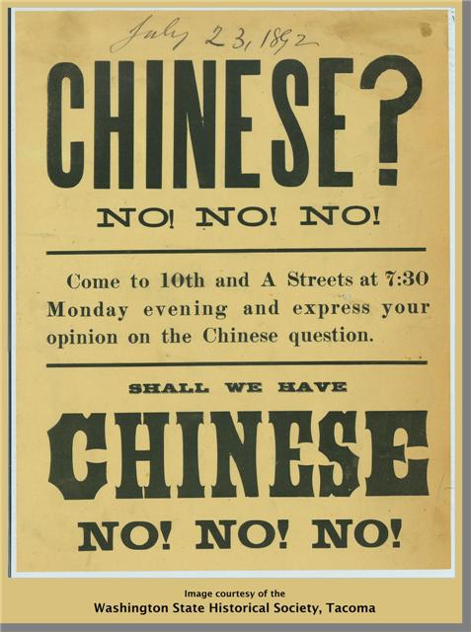
Harper’s Weekly, 1876. Smithsonian Institution Libraries, http://americanhistory.si.edu/onthewater/exhibition/5_2.html
3
1882 After a 30-year influx of Chinese immigration for work in gold mines and on the transcontinental railroad, Congress passed the Chinese Exclusion Act, prohibiting all Chinese immigration and denying citizenship for those already in the U.S. Promised to be temporary, it wasn’t repealed until 1943. This was the first law passed by Congress to regulate immigration. Chinese made up 0.002% of the U.S. population at the time.
Notes:
I think this works well.

Slide 7
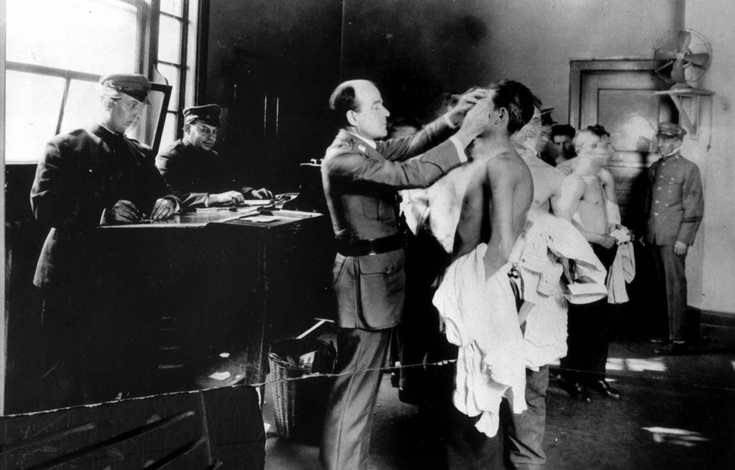
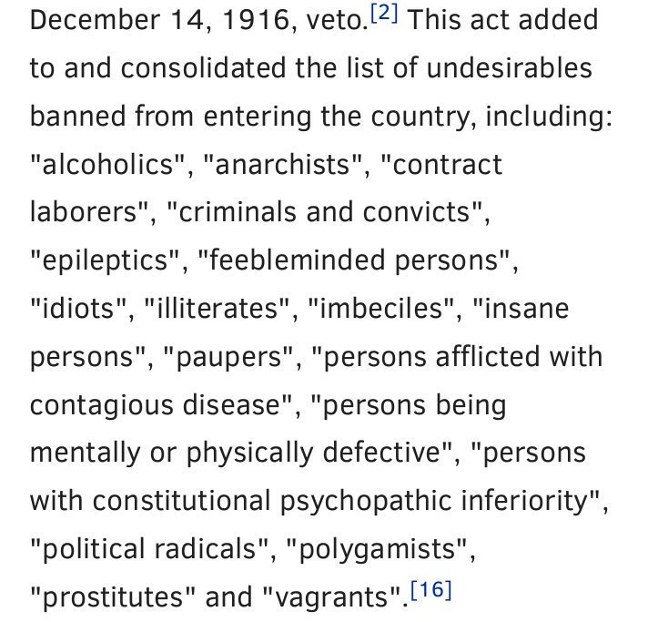
http://davidderrick.files.wordpress.com/2009/02/angel_island.jpg
4
1917 Congress pushed through the controversial Asiatic Barred Zone Act, barring immigrants from more Asian countries. The bill also imposed a literacy test and tax on all incoming immigrants, and restricted the entry of those with mental and physical handicaps. This remained U.S. immigration policy until 1952.
Notes:
what language for literacy test (?) Native language or English? - Asiatic Barred Zone Act is also called the Immigration Act of 1917. Literacy tests involved having immigrants read 30-40 words in their own language of plain text - Wikipedia, http://library.uwb.edu/Static/USimmigration/1917_immigration_act.html
Immigration Nationality Act (?) what’s the best thing to call this.
Can you find an article on why did President Wilson vetoed it? We are thinking about including it in a new CBB book so it should be pretty easy to read/not too long. - It was vetoed by President Wilson because it denied equal opportunity to those who had not been educated; https://en.wikipedia.org/wiki/Immigration_Act_of_1917; Koven, Steven G.; Götzke, Frank (2010). American Immigration Policy: Confronting the Nation's Challenges. New York, New York: Springer Science & Business Media. ISBN 978-0-387-95940-5.
Was a tax put on all incoming immigrants or just Asians? - It barred immigration from several Asian countries completely and put an $8 tax on immigrants from other countries.
http://immigrationtounitedstates.org/588-immigration-act-of-1917.html
Is it possible to find photo of a list of all the “undesirables”? When you research this more you’ll see what I mean by that.
Asiatic Barred Zone Act is also called the Immigration Act of 1917. Literacy tests involved having immigrants read 30-40 words in their own language of plain text - Wikipedia, http://library.uwb.edu/Static/USimmigration/1917_immigration_act.html

Slide 8
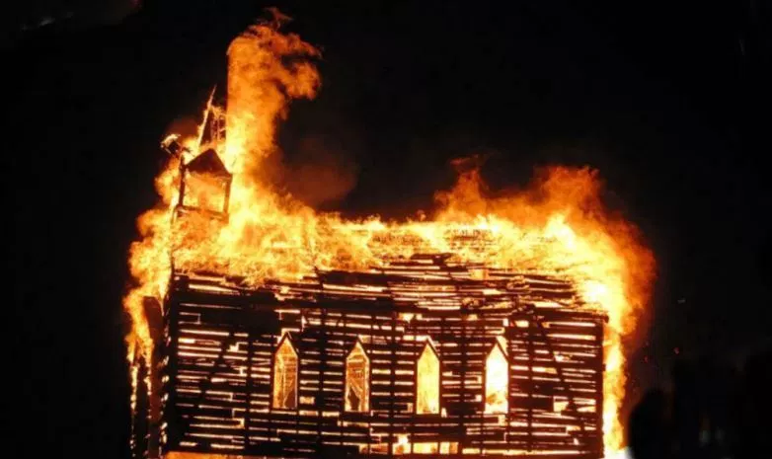
6
5
1914-1918 During World War I, Germans and other recent immigrants from Eastern Europe became the targets of anti-immigrant suspicion. This fear spilled over to others: socialists, anarchists, African-Americans, labor unions, and other immigrants. Dutch Reformed communities even experienced discrimination for being mistaken for Germans.
Notes:
http://www.npr.org/2017/04/07/523044253/during-world-war-i-u-s-government-propaganda-erased-german-culture

Slide 9
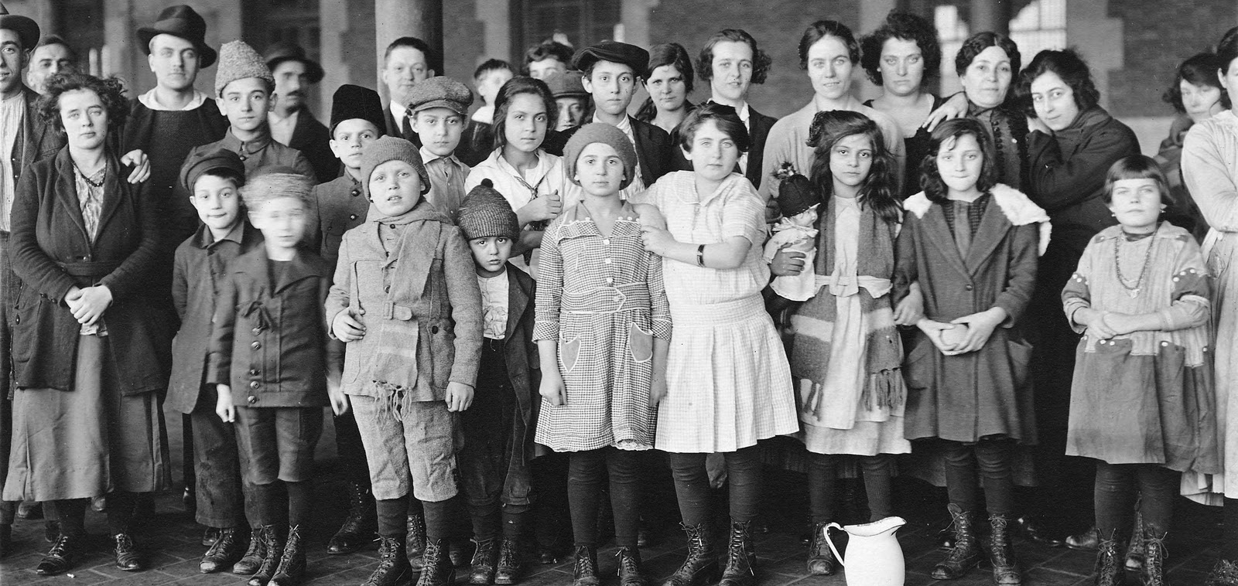
“Immigrant Children, Ellis Island, New York.” Brown Brothers, ca. 1908. Records of the Public Health Service. http://www.archives.gov/press/press-kits/1930-census-photos/photos-2.html
6
1921 The Emergency Quota Act introduced a quota system which favored immigrants from northern European countries, specifically intending to limit immigration from southern and eastern European countries. Professionals were permitted to enter regardless of country of origin.
Notes:
It did not, however, establish quotas of any kind for residents of the Western Hemisphere.
WHY eastern+southern immigrants? Fascism? Was it politically motivated?
What are the undercurrents for this act? Was it intended to be temporary?
The Emergency Quota Act restricted the number of immigrants admitted from any country annually to 3% of the number of residents from that same country living in the United States as of the U.S. Census of 1910 - Wikipedia
It was intended to be temporary but set a precedent for counting immigrants and using quotas. It followed a large push to exclude anyone who was foreign born. Unemployment was also very high following the conclusion of WWI - http://study.com/academy/lesson/immigration-quota-system-of-1921-definition-overview.html
“Many Americans held the perception that individuals from southern and eastern Europe could not be assimilated properly into the culture of the United States. Their languages, customs, and religions were thought to be too different from those of preceding generations of immigrants for fullscale integration into American culture. The fear was that these newer immigrants would always be "hyphenates,” or citizens who would call themselves, or be called by others, by such hyphenated names as "Polish-Americans,” "Greek-Americans,” and "Italian-Americans.”
Beyond the fear of being swamped by unassimilable immigrants from eastern and southern Europe was the fear that these immigrants’ increasing numbers would depress wages for American workers. In addition, some people feared the potential of the rising political power of the new class of immigrants. To counter the tide of uneducated, working- class immigrants, professionals were allowed to enter the United States with few restrictions, regardless of their nations of origin.” - http://immigrationtounitedstates.org/589-immigration-act-of-1921.html
“The Emergency Quota Act was passed restricting immigration following many events in the United States that provoked anti-immigration hysteria including the 1919 recession and high unemployment, civil unrest, the Red Scare and the policy of Isolation adopted by the US Government.” - http://www.american-historama.org/1913-1928-ww1-prohibition-era/1921-emergency-quota-act.htm

Slide 10
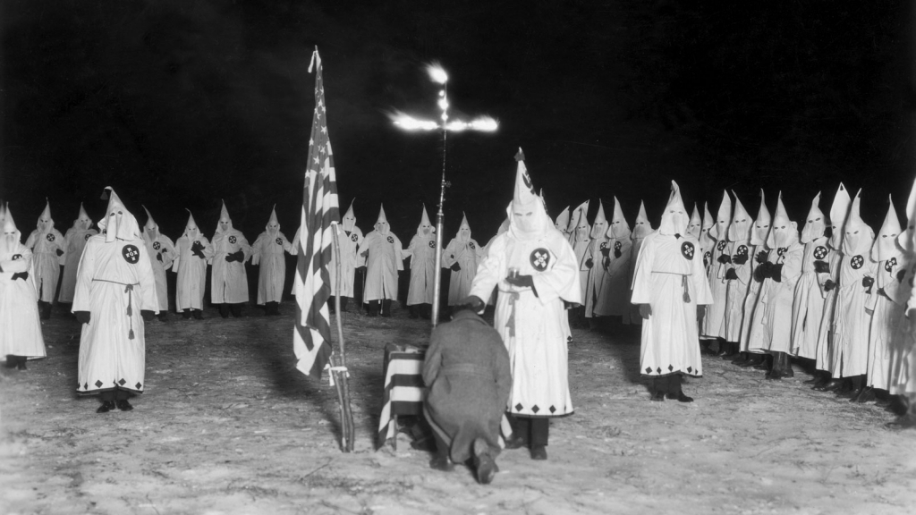
Jack Benton, Hulton Archive/Getty Images
7
1919-1923 Growing isolationist sentiments led to rapid growth in the Ku Klux Klan, a white supremacist organization that emphasized white supremacy and nativism, under the slogan “Keep America American.”
Notes:
source: http://www.american-historama.org/1913-1928-ww1-prohibition-era/1921-emergency-quota-act.htm

Slide 11
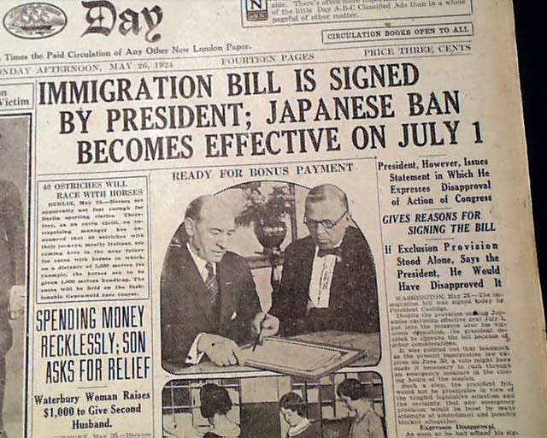
8
1924 The Immigration Act of 1924 aimed to further restrict immigration by lowering the 1921 quotas and banning all Asian and Arab immigrants. The law intended to curtail immigration of Jewish individuals from eastern Europe. It did not restrict western European immigrants; 87% of visas went to immigrants from Britain, Ireland, Germany, the Netherlands, and Scandinavia.
Notes:
Immigration Act of 1924, further reduced immigration from non western european countries
Arabs, and more --ensured America had specific dominant culture

Slide 12
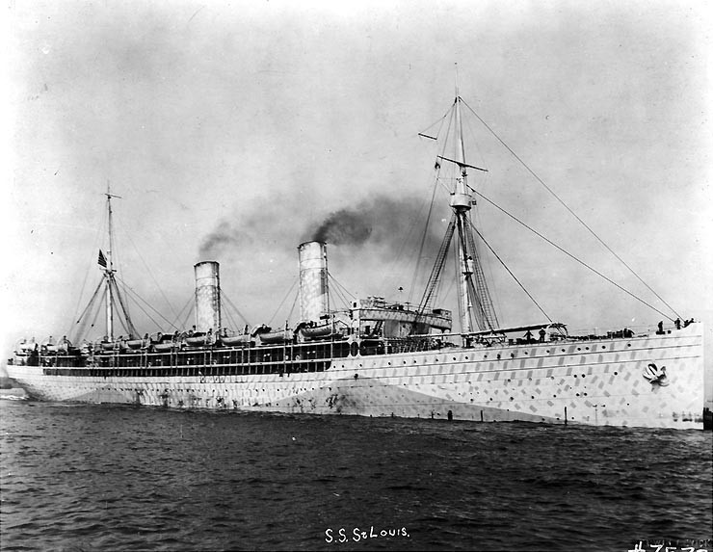
9
1939 900 German refugees aboard the St. Louis ship, fleeing the Nazis, were sent back to Europe after being denied asylum because of the ethnic quotas imposed by the Immigration Act of 1924. They were also rejected by Cuba and Canada. A quarter died during the Holocaust.
Notes:
can we use this pic?

Slide 13
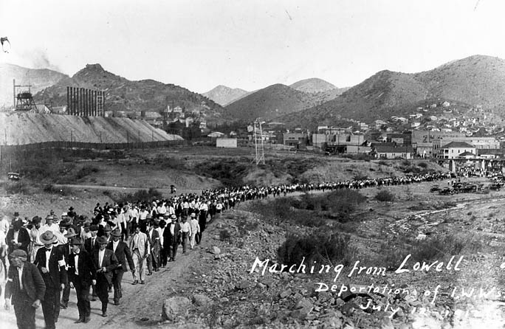
AHS, Pictures-Places-Bisbee-Bisbee Deportation, #43174.
10
1930s During the years of the Great Depression, up to one million Mexicans and Mexican-Americans were sent to Mexico – some “voluntarily,” others by force. 60% were American citizens of Mexican descent.

Slide 14
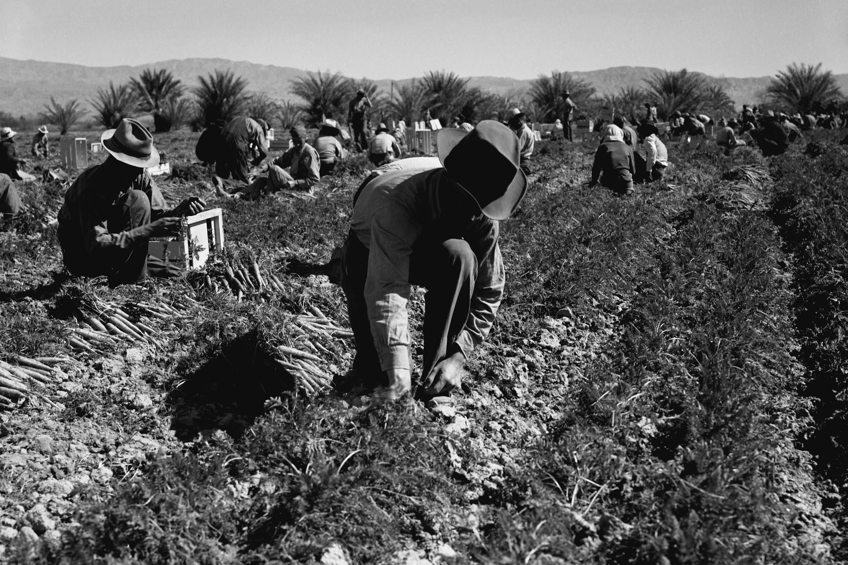
Buyenlarge/Getty Images
11
1942-1964 The Mexican and U.S. governments developed the Bracero Program, offering temporary agricultural contracts to Mexican workers due to the lack of American workers during WWII and desire to mitigate unlawful immigration. The program called for workers to be guaranteed wages, housing, food, and exemption from military service, however these terms were often ignored by employers.

Slide 15
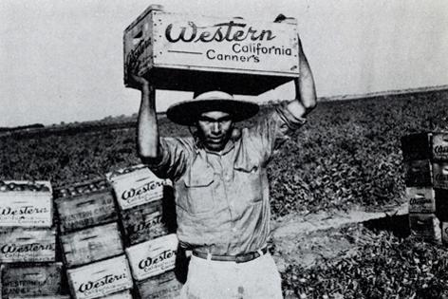
12
1954 President Eisenhower’s Operation Wetback aimed to deport undocumented immigrants. Methods included police raids of Mexican-American neighborhoods, interrogations of “Mexican-looking” citizens in the street, and forced deportations of Mexicans and several hundred U.S. citizens. In only a few months, over 1 million individuals were deported.
Notes:
“Wetback” itself was a derogatory term, referring to immigrants who had supposedly swam through the Rio Grande to enter the US.
Can you find any context for why it began? What instigated this? - “originated from a request by the Mexican government to stop the illegal entry of Mexican laborers into the United States.” - Wikipedia
“Operation Wetback was primarily a response to pressure from a broad coalition of farmers and business interests concerned with the effects of Mexican immigrants living in the United States without legal permission” - Wikipedia, from Koulish, 2010
The Bracero Program preceded this, which allowed temporary Mexican laborers to enter the United States during WWII to provide cheap labor. This ultimately failed to reduce illegal immigration, and then Operation Wetback was put in place. https://en.wikipedia.org/wiki/Operation_Wetback
Can you find a photo of an official document with the words Operation Wetback?
When did it end and why?
This source said it ended towards the end of 1954 as funding ran out: https://tshaonline.org/handbook/online/articles/pqo01
Bracero Program didn’t end until 1964

Slide 16
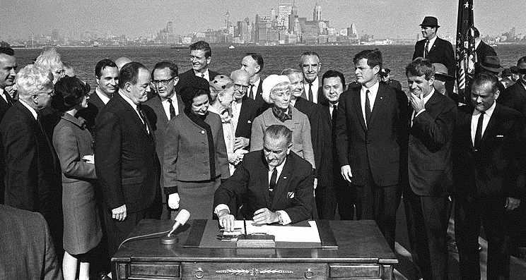
Lyndon B. Johnson Library Collection/Yoichi R. Okamot
13
1965 The Immigration and Nationality Act of 1965 disbanded the quota system, eliminating nationality as basis for admittance to the U.S., allowing more non- western European immigrants to arrive. Immigrants today enter primarily based on family relationships and employment skills.

Slide 17
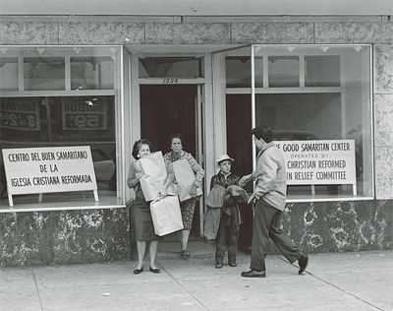
U.S. Coast Guard official photo. http://www.uscg.mil/history/uscghist/camarioca1965.asp
14
1965 Cuban refugees, admitted with special visas because of the country’s communist revolution, were sponsored and supported by the Christian Reformed Church. Over the next ten years, World Renew’s Good Samaritan Center in Miami would help more than 2,500 people.

Slide 18
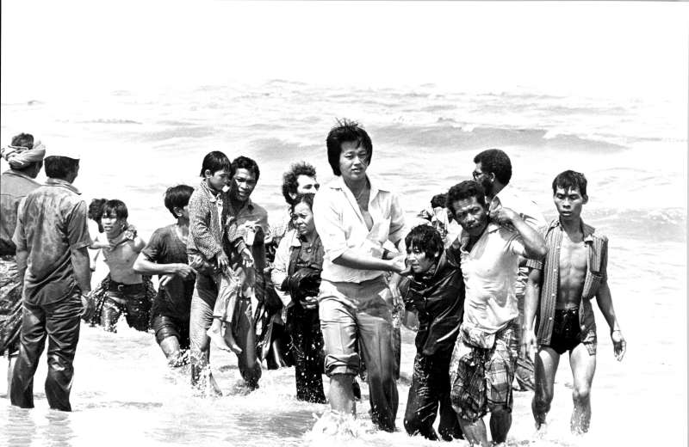
15
1968 United States signs the “Protocol Relating to the Status of Refugees,” a key treaty including 146 countries. Before this, “refugees” were generally defined only as European victims of WWII; by removing time and geography restrictions, others fleeing persecution could be considered refugees.

Slide 19
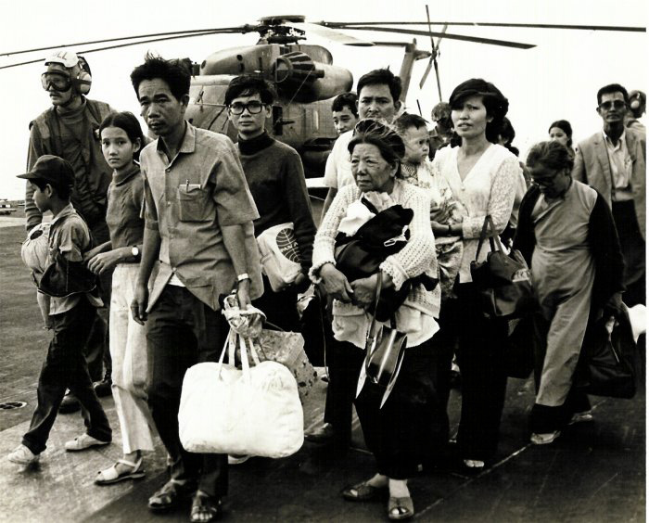
“Vietnamese Refugees on US carrier,” Operation Frequent Wind. Wikipedia Commons.
16
1970-1980 After the fall of Saigon in 1975, President Ford created a task force to admit over 130,000 South Vietnamese refugees in just one year. The faith community, including Christian Reformed congregations, welcomed an influx of refugees from war-torn countries in Southeast Asia like Cambodia, Laos, and Vietnam.

Slide 20
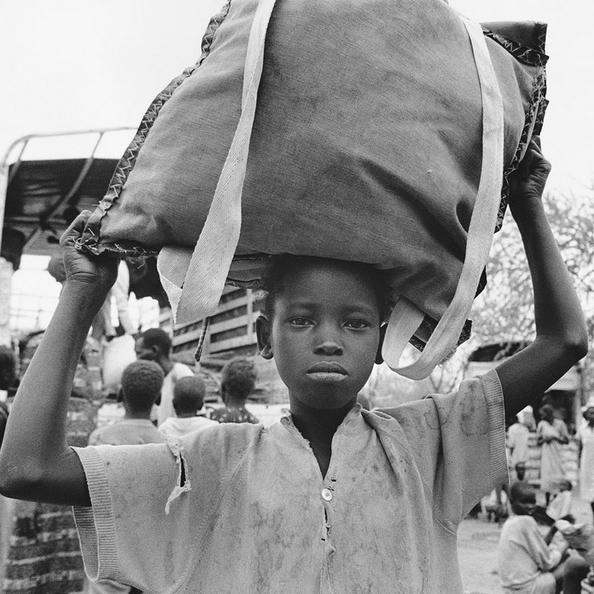
UNHCR/B Press. Church World Service.
17
1980s-1990s The Christian Reformed Church and other religious groups welcomed West African immigrants seeking asylum from political upheavals and violence in their home countries.

Slide 21
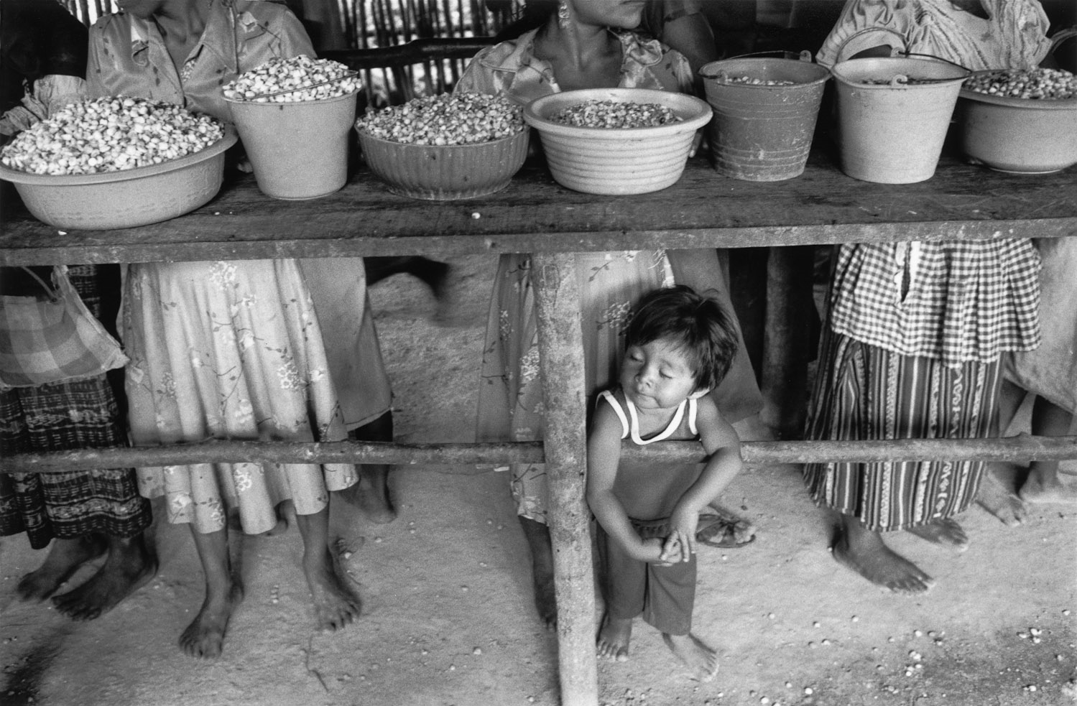
http://www.johnvink.com/JohnVinkSite/Refugees_Stories/1986_88_Guatemalan_Refugees_in_Mexico/index.html#VIJ1988006W00043_18
18
1980-1990s Hundreds of thousands of Guatemalans and Salvadorans fled their countries due to civil war, repression, and economic devastation. Because the U.S. would not admit them as asylum seekers, churches began the Sanctuary Movement to protect them from deportation. They successfully advocated for changes to asylum law.

Slide 22
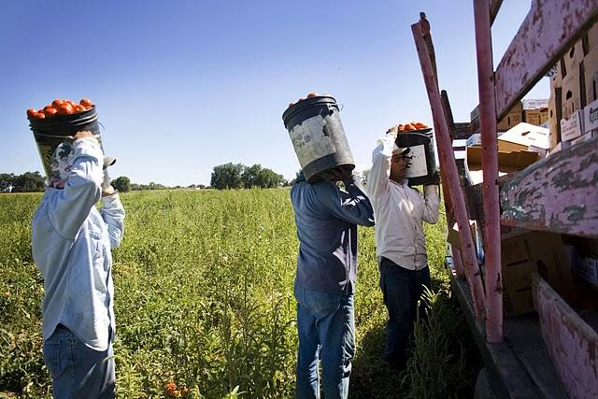
http://www.coloradofarmworkers.com/
19
1986 President Reagan signed the Immigration Reform and Control Act (IRCA), a bipartisan compromise which offered amnesty to almost 3 million undocumented immigrants, imposed penalties on employers who hire undocumented workers, and increased enforcement at U.S. borders. No changes were made to the legal immigration entry process.

Slide 23
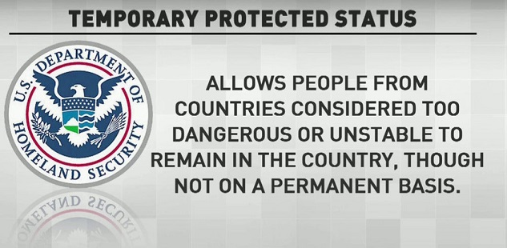
20
1990 The Immigration Act of 1990 created a new visa category called the Diversity Visa intended to increase immigration from countries of low admittances, mainly within Africa and Asia. Among other provisions, it also created a new type of relief from deportation for nationals of countries where it is not safe for them to return, known as “temporary protected status,” explicitly designating Salvadorans. It has since be designated to countries all around the world.
1990 The Immigration Act of 1990 created a new visa category called the Diversity Visa intended to increase immigration from countries of low admittances, mainly within Africa and Asia. It also created a new type of relief from deportation, Temporary Protected Status (TPS), for individuals from designated countries where it is unsafe to return.

Slide 24
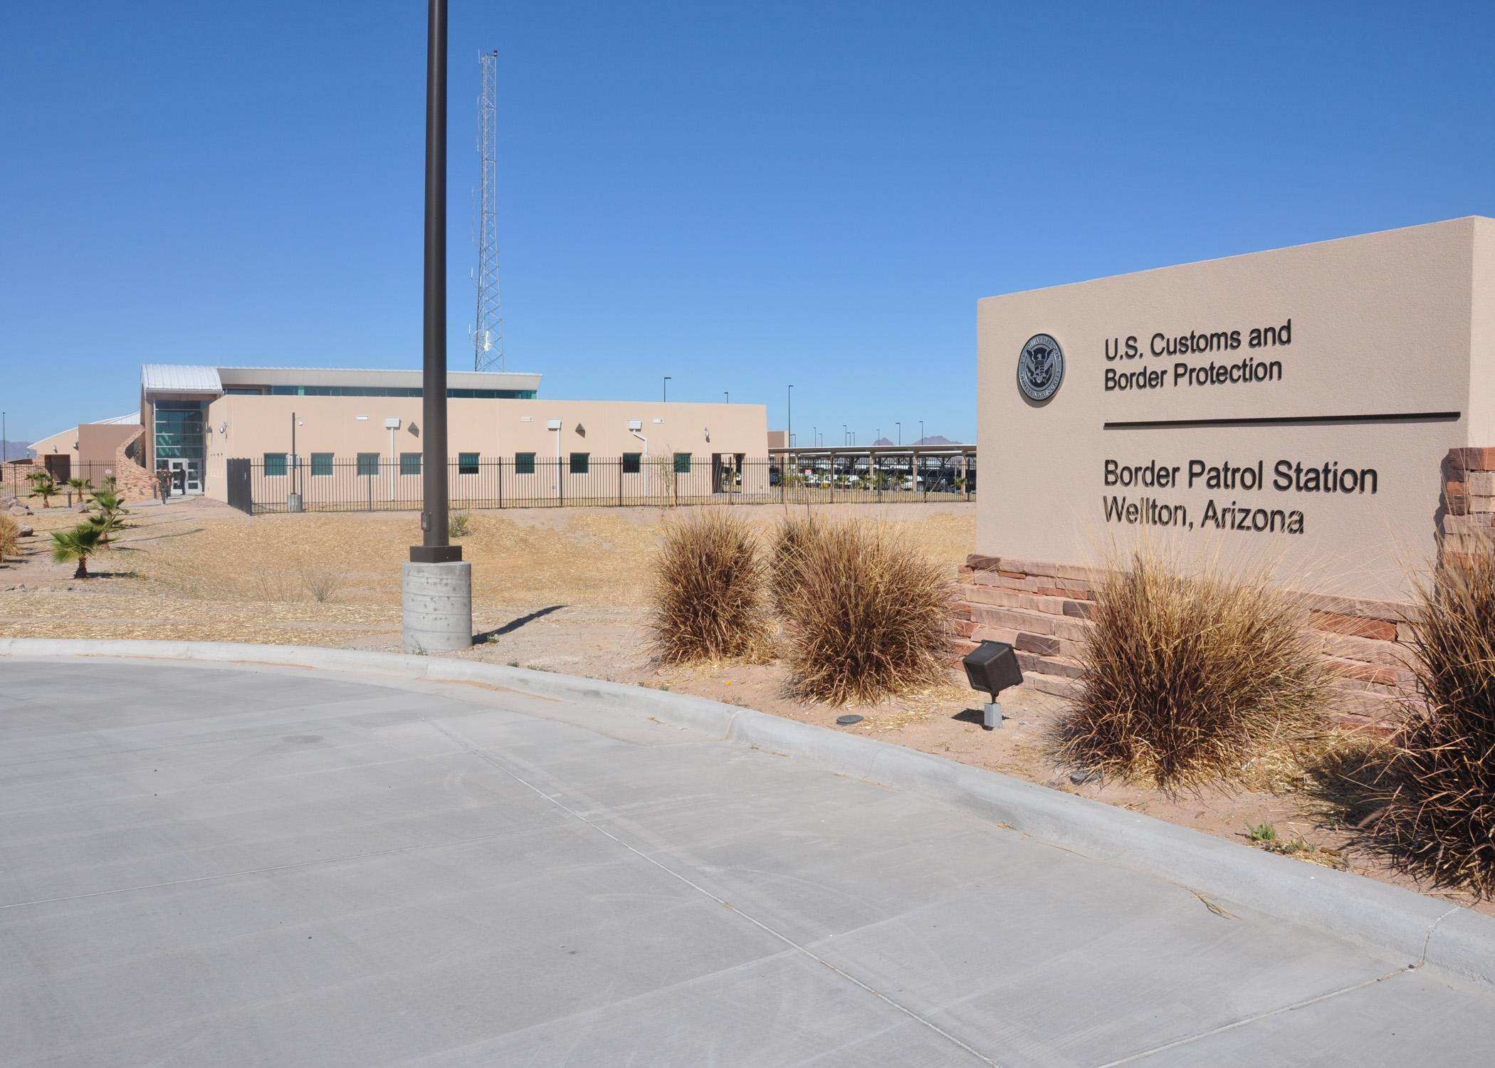
Flickr/USACE Public Affairs
21
1996 The Illegal Immigration Reform and Immigrant Responsibility Act, a “tough on crime” measure, attempted to address illegal immigration through mass detention and deportation. It made past or minor crimes deportable offenses, enacted 3- and 10-year bars for legal re-entry for those who had been in the country unlawfully, expanded border enforcement, and added more penalties for employing undocumented immigrants.
Notes:
http://immigrationtounitedstates.org/577-illegal-immigration-reform-and-immigrant-responsibility-act-of-1996.html

Slide 25
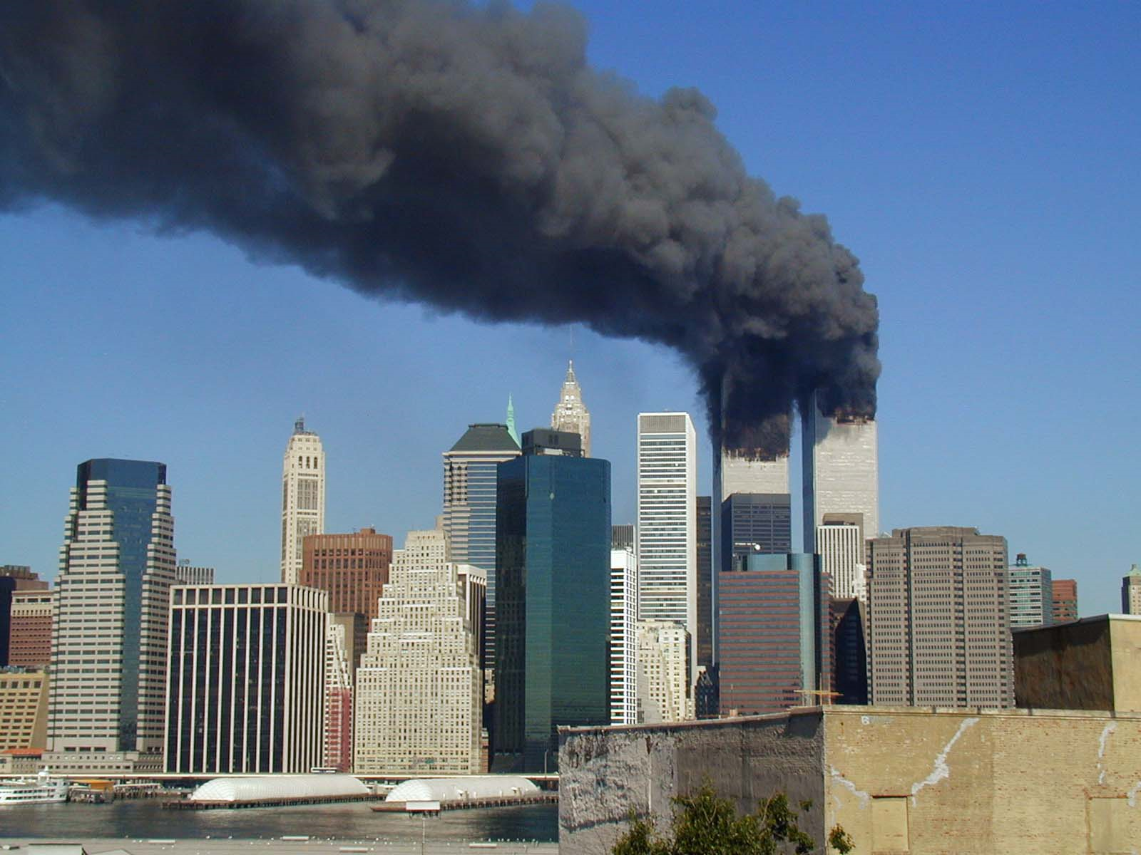
World-Trade-Center Attack by Michael Foran (Flickr) vie Wikimedia Commons
22
2001 The World Trade Center in New York was attacked by terrorists who entered the United States on non-immigrant (temporary) tourist visas. The shock of this event increased an anti-Arab and anti-Muslim sentiment, engendered patriotism, and led to legislative changes to immigration laws.
Notes:
note for facilitator re non immigration

Slide 26
23
2001-2002 The Patriot Act is signed, restricting immigration based on a broad definition of terrorism. The Department of Homeland Security is created, placing immigration services under its authority; previously it had been administered under the Department of Labor (until 1940) and then the Justice Department.

Slide 27
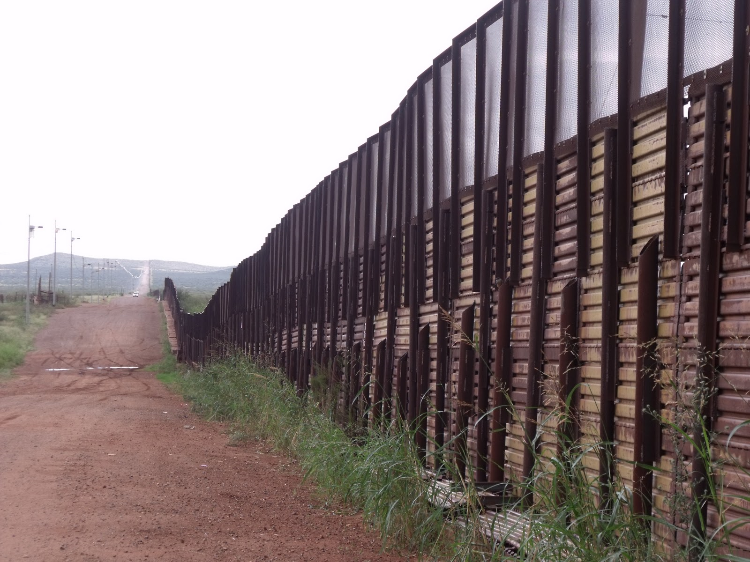
http://borderlinesblog.blogspot.com/2010/11/last-best-chance-to-defend-arizona.html
24
2006 President Bush signed the Secure Fence Act for construction of a $3 million per mile, 700-mile physical wall along sections of the U.S.-Mexico border, and a “virtual wall,” using of cameras, sensors, and drones in other places. The fence forced immigrants to cross in dangerous places, causing a spike in deaths along the border, or pay high prices for human smugglers.
Notes:
$3.8 million per mile just for materials in easy terrain - http://www.npr.org/templates/story/story.php?storyId=6388548
Estimated $50 billion for the entire fence, including maintenance, over 25 years: https://www.bostonglobe.com/news/politics/2017/01/26/when-wall-was-fence-and-democrats-embraced/QE7ieCBXjXVxO63pLMTe9O/story.html

Slide 28
25
2012 President Obama announced Deferred Action for Childhood Arrivals (DACA), a executive order allowing Dreamers who meet certain criteria to receive 2-year periods of protection from deportation and work authorization.

Slide 29
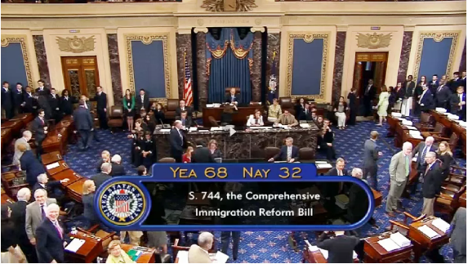
26
2013 After failing in both 2006 and 2009, a bipartisan compromise to reform immigration passes the Senate. It increased border security while also providing a path to citizenship for some undocumented immigrants. But controversy over thousands of asylum-seeking children from Central America influenced political will in the House, and the bill expired.
Notes:
“when we get scared, we get racist toward immigrants”

Slide 30
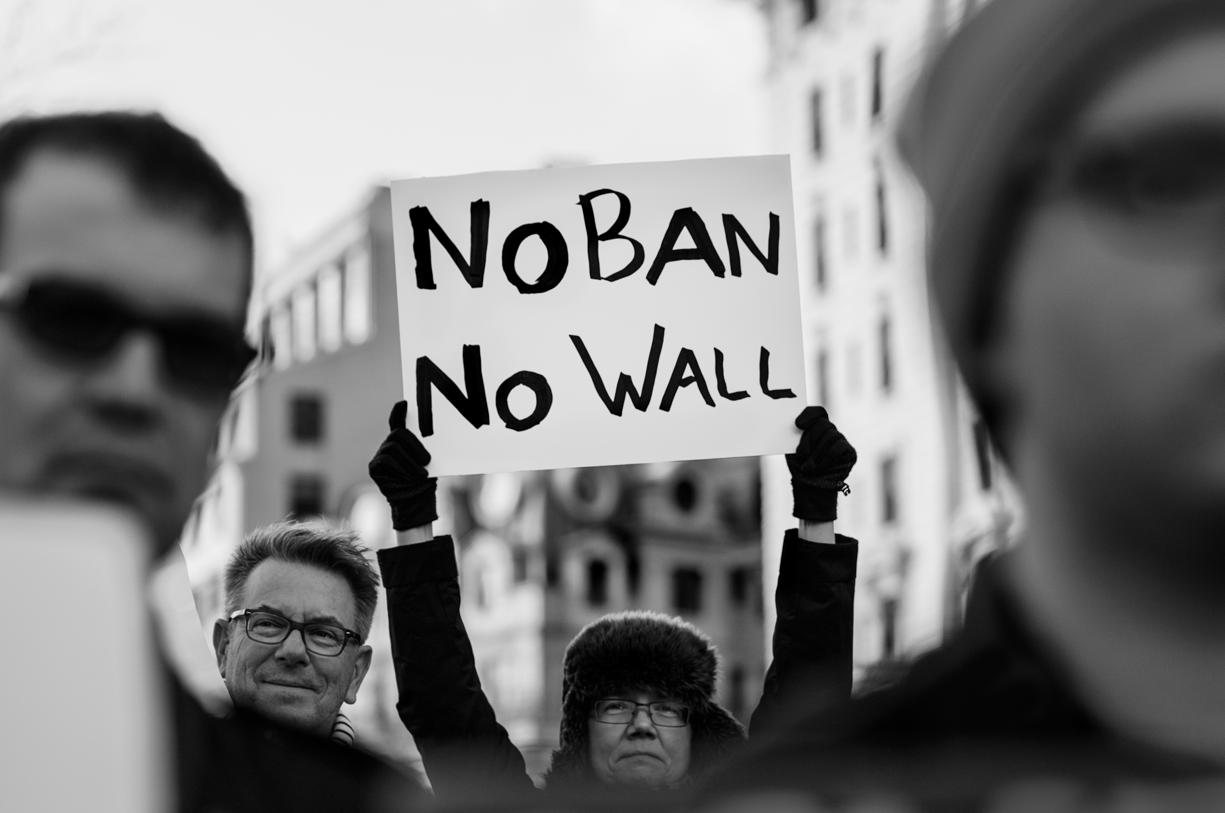
27
2017 After running on a boldly anti-immigrant platform, President Trump's initial actions in office are executive orders dramatically increasing enforcement and deportation, blocking refugee resettlement, and attempting to ban travel from some Muslim-majority countries. Legal permanent residents are trapped at airports, with unclear rules regarding their ability to return to the U.S. Protests are sparked around the country. DACA is rescinded. Months of court battles ensue.

Slide 31
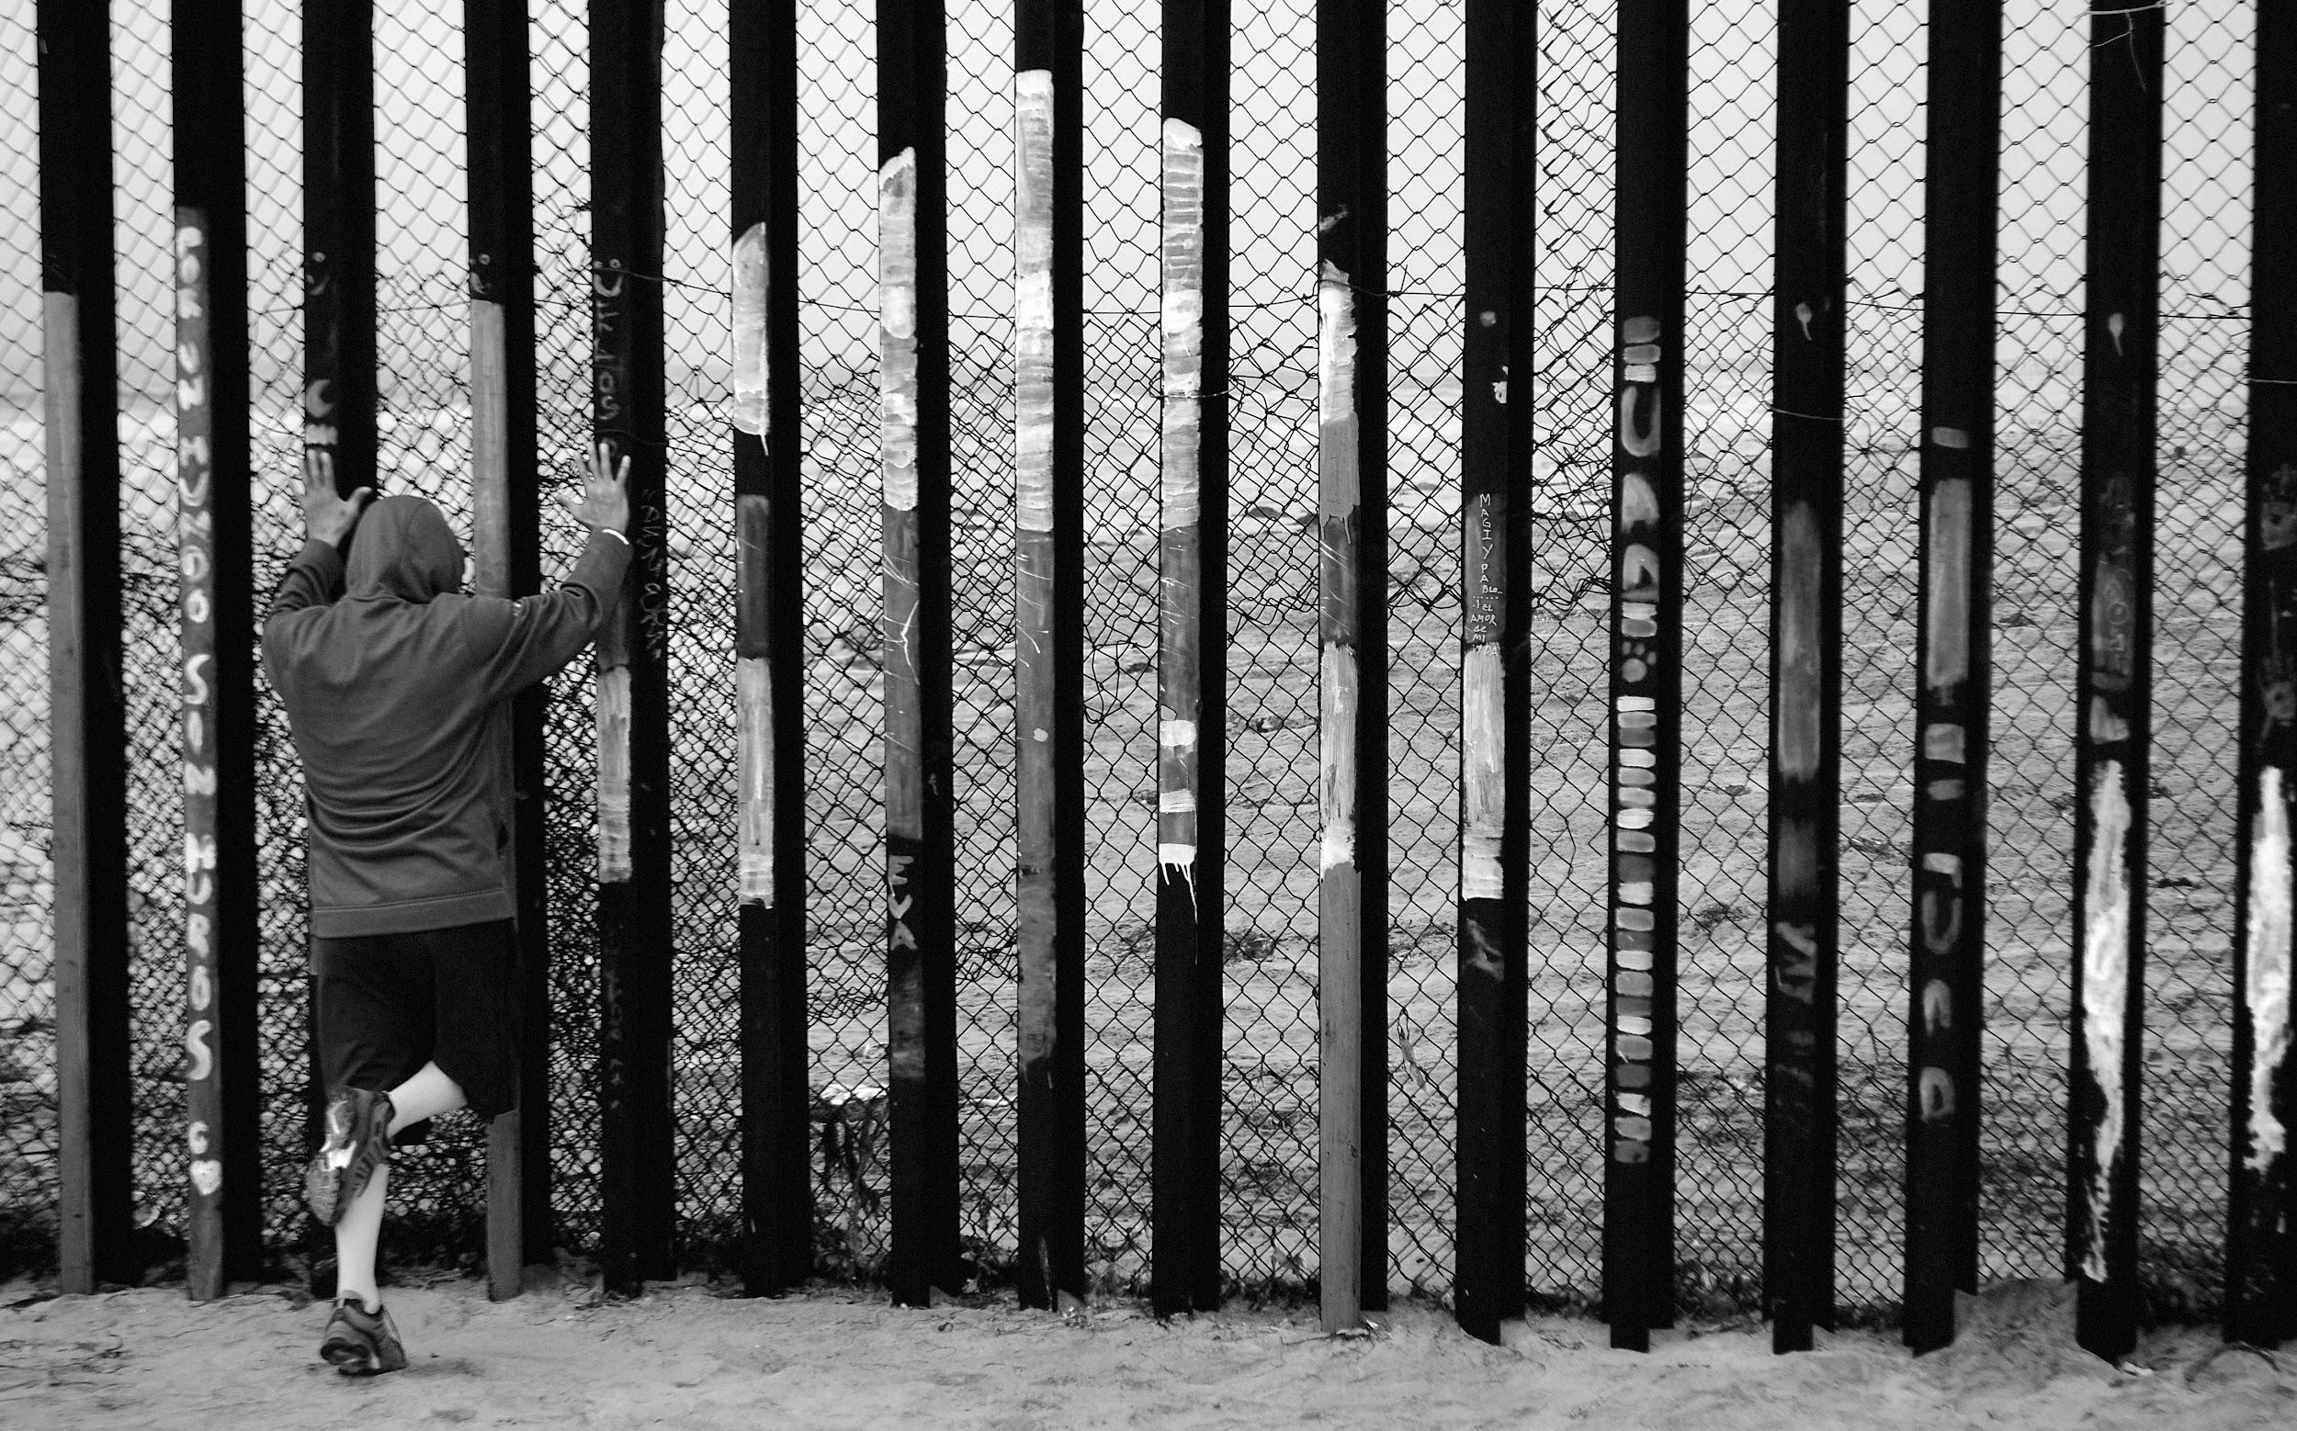
28
2018-19 Families and children increasingly ask for asylum, fleeing violence in Central America. The President’s "zero tolerance" policy separates families, some are not reunited; children are incarcerated. "Metering" policy creates long, slow lines for asylum processing. "Remain in Mexico" forces people to wait in Mexico for their day in American court. Asylum-seekers are required to apply for asylum in a through country before applying in the U.S.

Slide 32
29
2018-19 “Public Charge” rules are changed, expanding the criteria of immigrants who the government believes are likely to ever need social benefits (food or housing assistance) from being admitted or getting permanent residency in the U.S. Many immigrants stop accessing benefits for their U.S. citizen kids in fear that it will impact their ability to remain with their family.

Slide 33
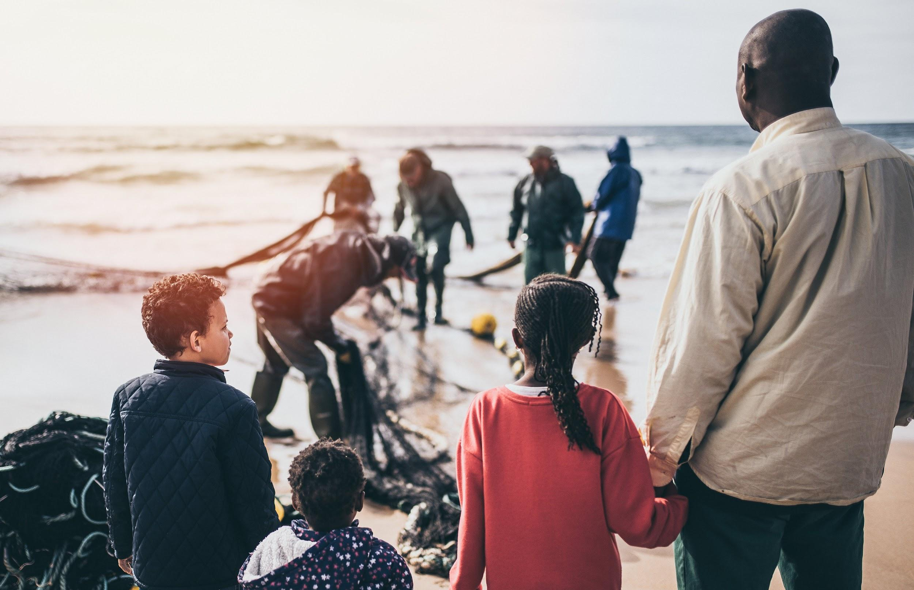
30
2019 The President's determination of refugee resettlement numbers are lowest ever: 30,000 in 2019, compared to 110,000 in 2016. Many faith-based resettlement organizations are forced to close. It is announced that the President cuts that number to 18,000 in 2020.

Slide 34
30
2020 As the world grapples with the global coronavirus pandemic, the president closes several more doors to legal immigration: access to asylum is effectively eliminated, diversity visa entries are suspended, and many pathways of family and employment immigration are shut down through at least the end of the year.

Slide 35
For what reasons have our immigration policies aimed to welcome immigrants or deny entry to immigrants?
Deny
Welcome

Slide 36
Reflection
What are the beliefs and attitudes underlying these hope and fears?
Based on our understanding of Scripture, what should our beliefs and attitudes be? How should they shape our policies?

Slide 37
We need immigration policy that:
Keeps families intact. Proposals which end the possibility of U.S. citizens reuniting with their adult children and siblings, and which prohibit permanent residents from reuniting with their children and spouses, go against the strong value of family that the church upholds. Family unity is not a threat to the U.S., and “chain migration” is a harmful piece of political propaganda that is not based on facts.
Creates more, not fewer, paths to legal immigration. Legal immigration is being threatened by these proposals. Justice in U.S. immigration policy would move toward laws which open up more legal pathways to immigration, not fewer.
Ensures permanent solutions for Dreamers. Some proposals offer only temporary protections. Proposals subjecting Dreamers to a lifetime of temporary status is not the solution they deserve.

Slide 38
For more information, visit
crcna.org/SocialJustice/immigration

Slide 39
2018
Family separations at the border (“zero tolerance” policy)
Public Charge (anyone considered a "public charge" to the government -- i.e. if they used or would be likely to use social benefits -- would no longer be considered for admission or adjustment of status to the U.S.)
grounds for asylum restricted (fleeing gang violence or domestic violence no longer counts)
2019
high numbers of visa application rejections because of Muslim Ban and Public Charge
historically low refugee resettlement numbers
Over a month long government shutdown over funding for the wall
Dream and Promise Act of 2019 passed the House but has yet to be picked up by the Senate
multiple policy threats/changes to restrict asylum and punish the countries that asylum-seekers flee from (metering, Remain in Mexico, threats to close the border, imposing tariffs on Mexico, pulling aid from Northern Triangle countries)
Notes:
2018-2019: family separation policy, and more restrictions to legal immigration: public charge, visa app rejections high due to Trump EO’s on immigration and the public charge, certain TPS designations ended, etc.

