Slide 1

They will live in safety and no one will make them afraid -Ezekiel 34:28
Notes:
So happy to see all of you here – Thank you for taking time to learn more about Safe Church Ministry.
(I know we have a lot of people, but if we could just go around, say your name, where you are from, and what made you decide to become involved in SCM)

Slide 2
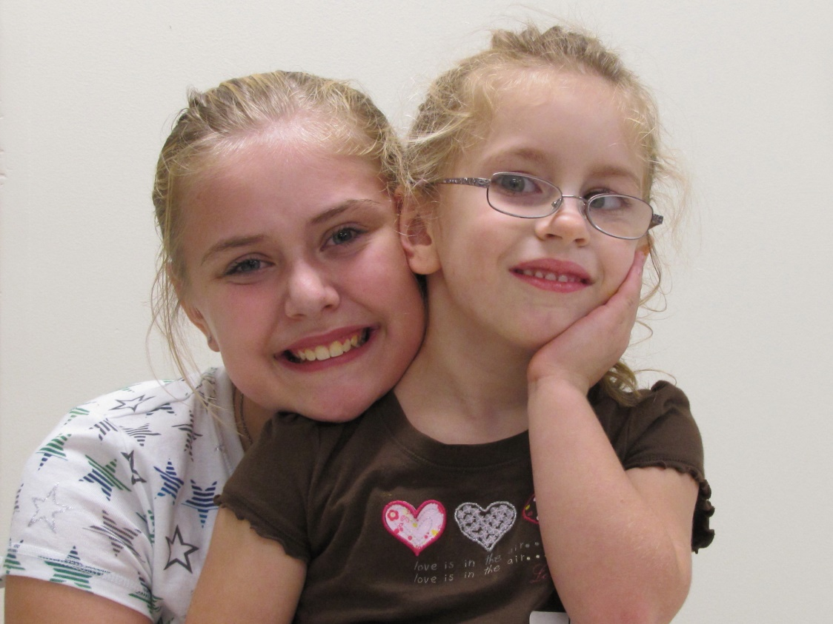
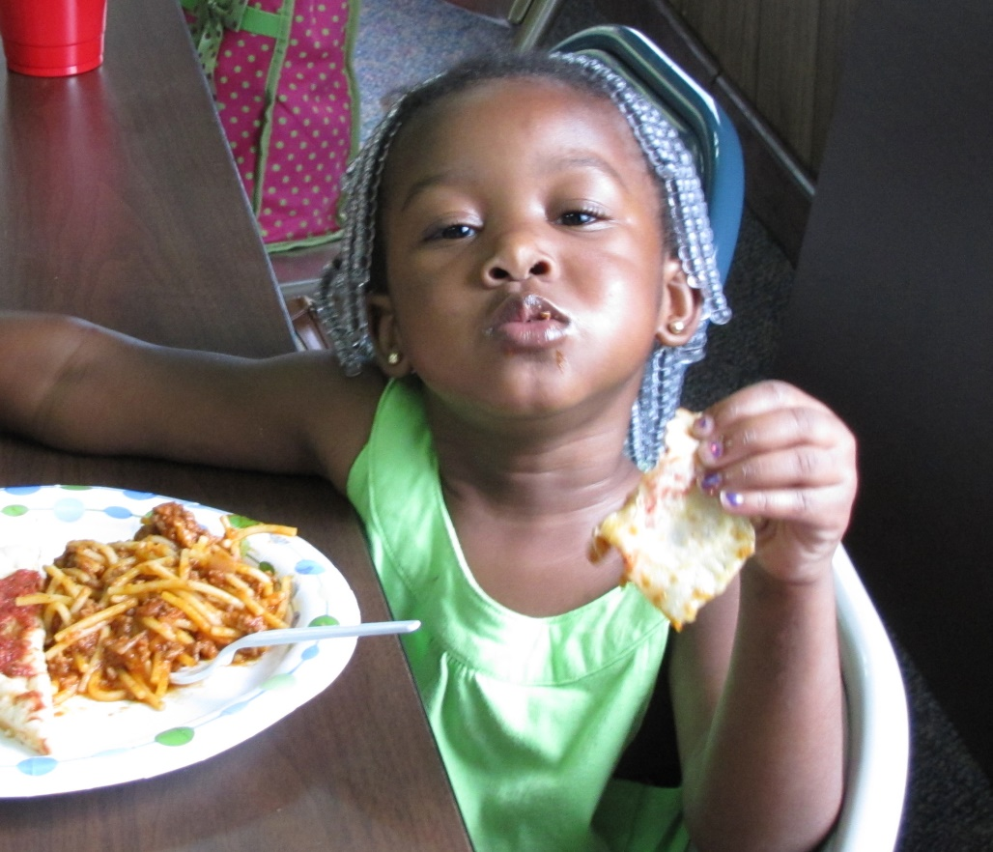
Equipping Congregations
in Abuse Awareness, Prevention, and Response
Notes:
I’m sure that we all have children in our lives, our own children, grandchildren, nieces, nephews, children in our congregation, children who we love and who bring us delight. And as precious as these children are to us – our Lord loves each of them even more than we can imagine. And all of us are children of God.
Just as we long for our children and grandchildren to grow up in a world and a church community where they are valued, nurtured and protected – that’s what God desires for all of us as well.
And, that’s really what SCM is all about.

Slide 3
Why Should My Church Care About Abuse?
It’s a Spiritual Thing
Our struggle is not against flesh and blood, but against the rulers, against the authorities, against the powers of this dark world and against the spiritual forces of evil in the heavenly realms.
-Ephesians 6:12
Notes:
Abuse is a spiritual darkness – we must remember that we are discussing a topic in which the forces of evil are fiercely fighting (and seemingly sometimes winning) against the kingdom of our Lord. Other organizations can work to end abuse, but only the Church has the spiritual resources to combat it at its source.

Slide 4
Bible Beginnings
God created human beings in his own image, in the image of God he created them; male and female he created them. …
And God saw all that he had made, and it was very good.
- Genesis 1:27 & 31
Humans, male and female, in God’s very image!
Notes:
In the beginning, before the Fall came and ruined everything… Men and women were together mandated to rule over creation, it was a partnership, they were naked and unashamed living with each other and with the Lord in a perfect world.
It didn’t last long – in Chapter 3 things fell apart. But the original beauty and dignity of creation still remains, even though it has been marred by sin. ALL people carry within them the image of their creator. ALL people are uniquely created with inherent dignity and worth. We are called to honor that, to love one another, care for one another, even the “least of these”. All of us, together, reflect our Lord, and each one has a unique part to play in that revelation.

Slide 5
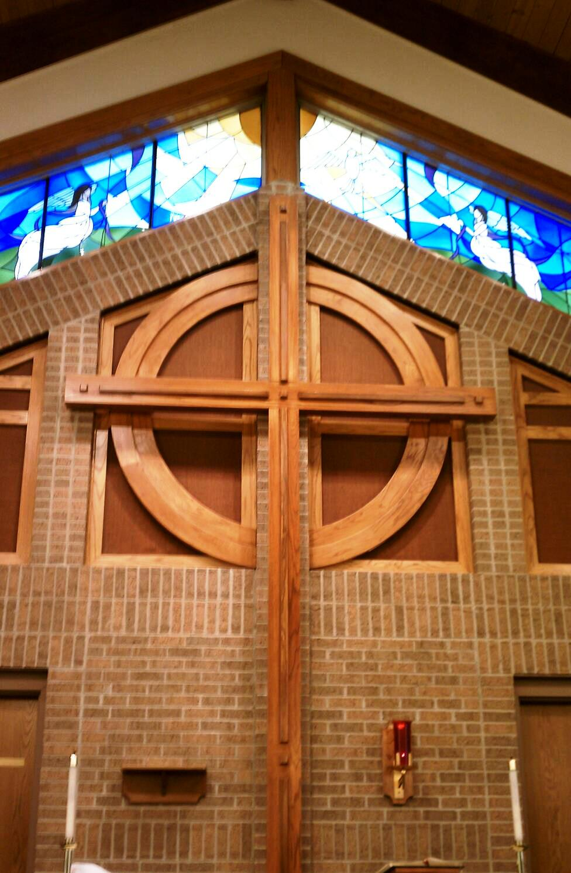
It’s Contrary to God’s Way
“In humility value others above yourselves, not looking to your own interests but each of you to the interests of the others.”
- Philippians 2:3-4
Notes:
A Question of Power
Abuse is all about power – even sexual abuse is much less about sex than having power and control over another person – sex is just an effective tool that’s used – Power used for selfish gain
The use of power in God’s Kingdom is opposite to the kingdoms of this world - Book “The Myth of a Christian Religion” by Gregory Boyd Power of Sword v. Power of God
Philippians 2 – Jesus is our example (gave up ultimate power, going to the cross)- Power used for love of others
Abuse in all its forms is about imbalance and misuse of power – it is contrary to the way of the Lord – it must not be allowed to continue in our churches

Slide 6
We Are One Body
“From him the whole body, joined and held together by every supporting ligament, grows and builds itself up in love, as each part does its work.”
- Ephesians 4:16
When one member hurts,
it affects the whole body.
Notes:
One Body
We are Christ’s Body – Image in Scripture, so rich and so powerful; and so counter-cultural to the individualism of our western society
One body says – we’re in this together – the parts are all connected, what affects one affects the other
Wounds need to be treated or they get worse
Ephesians verse “as each part…” we need each part; we need one another and need to care for one another

Slide 7
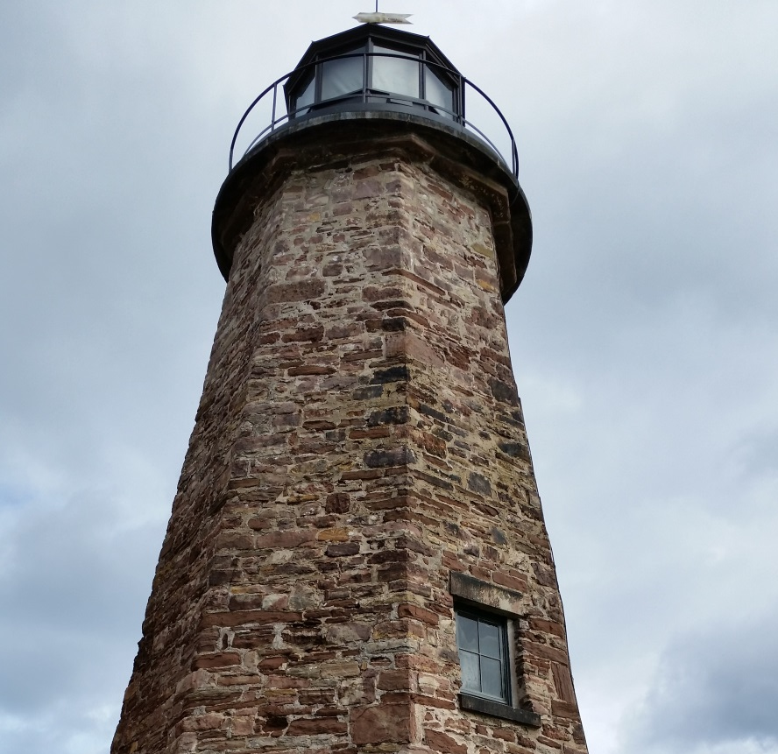
A Light to the World
“You are the light of the world. A city on a hill cannot be hidden… let your light shine before others, that they may see your good deeds and glorify your Father in heaven.
- Matthew 5:14-16
Notes:
Salt and Light
Related to last slides – we are called to be a light to the world/different from it
In our culture where people are not valued, are used, disrespected, and abused; our churches need to be safe havens where people are treated with infinite value, dignity, and love
Note – Jesus valued children & women – So counter-cultural for his day – We follow him
Early Christians turned their world upside down because they understood that they were to look different from their surrounding culture – it was appealing, people flocked to these communities where they were cared for, valued, and loved – We need to learn this

Slide 8
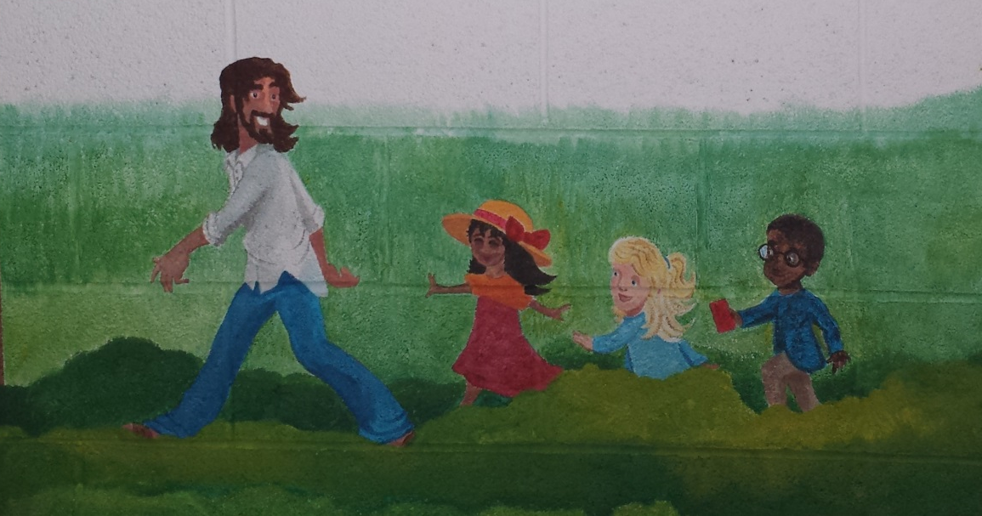
Jesus Loves Children
“If anyone causes one of these little ones—those who believe in me—to stumble, it would be better for them if a large millstone were hung around their neck and they were drowned in the depths of the sea.”
- Matthew 18:6
Notes:
Matthew 18:1-6 – Read:
At that time the disciples came to Jesus and asked, “Who, then, is the greatest in the kingdom of heaven?”
² He called a little child, whom he placed among them. ³ And he said: “Truly I tell you, unless you change and become like little children, you will never enter the kingdom of heaven. ⁴ Therefore, whoever takes a humble place—becoming like this child—is the greatest in the kingdom of heaven. ⁵ And whoever welcomes one such child in my name welcomes me.
⁶ “If anyone causes one of these little ones—those who believe in me—to stumble, it would be better for them if a large millstone were hung around their neck and they were drowned in the depths of the sea.
Pretty harsh words! We need to protect children and those most vulnerable.

Slide 9
It’s Real & Has Real Impacts
Child sexual abuse: 1 in 4 girls, 1 in 6 boys
Rape: 1 in 5 women, 1 in 71 men
Intimate partner violence: 1 in 3 women, 1 in 4 men
Teen dating violence: 10% of high school students hurt in the past 12 months
Notes:
Besides what the Bible tells us, our churches need to care about abuse because it’s real and has real impacts – It IS affecting our churches whether we know it or not
Our churches are full of people who have been impacted by abuse. Stats taken from the US Dept of Justice report & National Intimate Partner and Sexual Violence Survey (Center for Disease Control) 2010
Studies show that the statistics are similar among those who regularly attend church.
Look out over your congregation next Sunday, think 1 in 5 or 1 in 4 or 1 in 10 teens – we’re talking about a LOT of people
Many kinds of Impacts: See next two slides

Slide 10
Impacts on Children & Adults
Cognitive delay: language, intelligence…
Health Impacts: obesity, diabetes, intestinal issues, headaches…
Emotional & psychological impairment: attachment disorders, depression, anxiety, addictive behaviors, isolation …
Spiritual formation stunted: inability to believe that God is good, lack of trust, feeling unloved, loss of faith and hope …
Notes:
We are created and designed by God to be nurtured and cared for – not to be abused.
The effects of abuse are devastating. These same effects also show up when children witnesses abuse in the home; even if the abuse does not involve them directly.
Chemicals are released into the brain during traumatic events that have various impacts over time; cognitive, social-emotional, and also spiritual.
Effects last a lifetime!

Slide 11
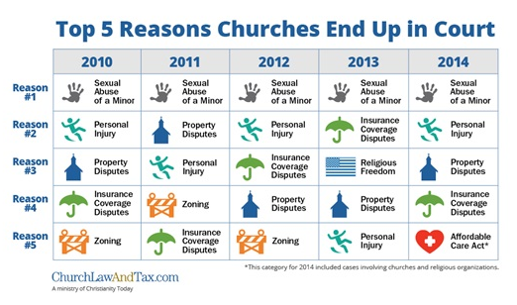
Child Sexual Abuse at Church
Notes:
Thankfully most child abuse doesn’t happen in church or involve a church leader, but some of it does. We can see here that sexual abuse against a minor is the number one reason that churches end up in court. And that has been true for many years. We simply must do better.

Slide 12
Not Just Children
Clergy sexual misconduct:
*Over 3% of women who attend church report that they have experienced clergy sexual misconduct (that’s 7 women in an average congregation of 400)
**“90-95% of victims of clergy sexual misconduct are female congregants. These victims are often so trapped in confusion, guilt, shame and self-blame that they are unable to see themselves as victims.”
*http://www.baylor.edu/clergysexualmisconduct/
** When Pastors Prey by Valli Boobal Batchelor
Notes:
And though we often think of protecting children, children are not the only ones who suffer abuse. In my position as director of Safe Church Ministry, I hear many stories of abuse. When I was on staff with InterVarsity, I heard many stories of abuse. And sexual abuse is also part of my own story. Most sexual abuse doesn’t involve clergy or ministry leaders, for that we can be thankful – but some of it does! And that’s a real problem for those who have been victimized by it because in those cases, it damages a person’s understanding God.

Slide 13
The Short Course on Abuse
Expect DENIAL from everyone, including you!
A good question to ask is, WHO HAS THE POWER?
What you know is probably only the “TIP OF THE ICEBERG”
Expect CHAOS when abuse is disclosed
Notes:
You may think it won’t happen to you – but stuff happens.
It’s far better to be proactive than reactive. Encourage discussions about some of these issues in council meetings.

Slide 14
The Vision
Imagine…
Safe Church Ministry equips congregations in abuse awareness, prevention and response. We help build communities where the value of each person is honored; where people are free to worship and grow free from abuse; and where abuse has occurred, the response is compassion and justice that foster healing.
Notes:
This is the vision that we want to keep before us – this is the vision that Safe Church Ministry is working toward
(read aloud slowly)

Slide 15
The Guiding Goals
Safe Church Top 5:
A safe church policy
A program for education
Approved protocols for response to church leader misconduct
Understanding and awareness of abuse
A commitment to safe church ministry (support for safe church teams)
Notes:
Gathering of Safe Church Team Chairpersons – 2011 – to brainstorm and envision – What is a truly safe church? (that’s where list came from)
Top 5 – Imagine what it would look like in your church
There is a lot of work to do; safe church is not primarily a reactionary ministry, ready to respond when abuse happens (although we want to be that too). Primarily we are a proactive ministry, promoting education, awareness and prevention as well as offering a healthy, effective response. We’d much rather work on the prevention side.
These are the goals that Safe Church Teams work toward, so that ALL our churches can be truly safe churches – It takes ALL of us to make a truly safe church – NOTE: All these must happen at the congregational level.

Slide 16
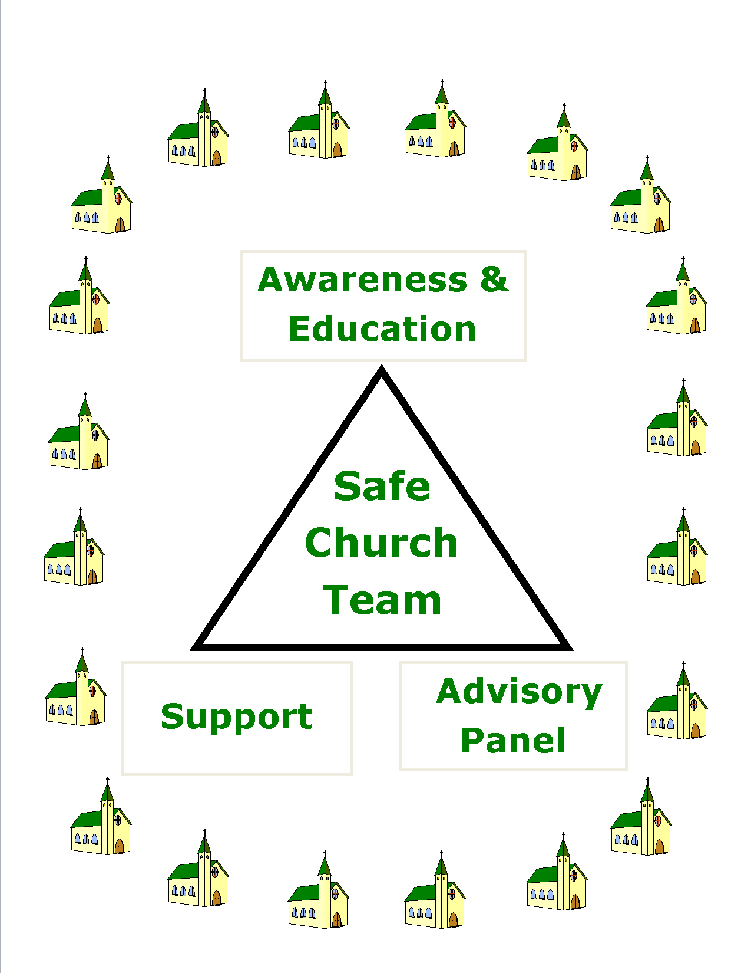
Safe
Church Team
Mandates
(from
synod)
Notes:
We can’t do it all from Grand Rapids – for over 20 years, Synod has encouraged each classis to have a Safe Church team, with these three mandates.
Three mandates – all are needed, they complement each other – three legged stool
Advisory panel – specially designed process for dealing with abuse by a church leader
Team concept – not everyone will have the same gifts and skills; together the team serves congregations, offer support, etc.
Imagine this multiplied all over Canada & US!

Slide 17
Structure Supports Vision
Ideally: Each Classis a team; each church a representative
Notes:
Here are where we had safe church team members in 2016. Some are part of a classis team, some are not. Safe Church depends on these volunteers for our work.

Slide 18
Safe Church at Every Level
Church Level
Classis Level
Policy
Education
Awareness
Support / Walk Alongside
Support Churches and Team Members
Ongoing Training
Special Events
Advisory Panel
What Can We Do Together
That We Could Not Do Alone?
Notes:
You will notice when looking at the 5 guiding goals that many happen at the congregational level. Yet synod has encouraged each classis to have a classis safe church team. Working at the various levels is important. Here’s how it might work. The classis team can support and encourage what is happening at the congregational level.

Slide 19
Policy: A Place to Start The #1 Prevention Strategy
How would you respond?
We all know each other here
We just don’t have the time or resources to create a policy
We don’t really have many children
Notes:
How would you respond to these questions?

Slide 20
Rationale For a Policy
To create a safe place in church
To protect children
To protect staff and volunteers
To create an opportunity to talk about abuse
To respond to situations of abuse
To satisfy legal counsel’s request
To satisfy insurance co. requirements
Notes:
Knowing the reasons, or why we have church policies, may help motivate those who don’t see the need for a Safe Church policy.
It is the responsibility of the church council to provide a safe space that nurtures worship and faith – with a special mind to those most vulnerable among us such as our children.
Policies also protect church staff and volunteers from false allegations – very important in our culture of litigation.
Legal counsel and insurance agents – should review all policies – excellent sources of information regarding reducing risk.
Having a policy sends a message that in this place, the infinite value of each person is honored and respected; therefore abuse is not tolerated.
(Recommend posting policy on church website)

Slide 21
Important Considerations
POLICY MUST BE MAINTAINED & FOLLOWED!!!
Keep it simple
Supervision and accountability
Regular review – committee, legal counsel, insurance agent
Annual Training of staff & volunteers
Notes:
A policy that is approved and then sits in a file somewhere is not helpful. I’ve asked pastors whether or not their church has a Safe Church or abuse prevention policy and gotten the answer, “I don’t know”. I’ve heard church leaders say, “we used to have a policy, but I’m not sure where it is.”
If no one knows about a policy, it’s not doing any good. Policies must be followed.
Supervision and accountability should be incorporated into the policy – so should regular review and training of staff and volunteers.
Training staff and volunteers is another role for classis Safe Church Team members. Offering to do a training for staff and volunteers each year is a way to keep safe church in the minds of church leaders.

Slide 22
Beyond Policy …
Team Concept – Various Gifts, Skills, Interests, Contexts, Resources…
Specific Callings – Support Groups, Recovery Programs, Advocacy, Collaboration with other Organizations …
The Basic Minimum vs. The Sky’s the Limit
What are you willing to do?
Notes:
You’ve seen our basic mandates from synod. But the whole idea of a team concept is that everyone has different interests, gifts, and skills. There are minimum things that we would like to see in place – as our 5 guiding goals state.
But…
There is so much more that we could be doing! Really, the sky is the limit.

Slide 23
Safe Church Ministry A Resource for YOU
Website: www.crcna.org/safechurch
Network: http://network.crcna.org/
Director: bnicholas@crcna.org 616-224-0735
Classis and Regional Safe Church resources
Notes:
Safe Church is here for to be a resource to you
We can strategize together about ways to move Safe Church Ministry forward
Really, don’t hesitate to contact Safe Church Ministry
Website – an excellent resource! Constantly being updated – refer to it regularly

Slide 24

Questions?

